Slide 1
The Australian Legal System
BUS107 Commercial Law
Week 1 Lecture

Slide 2
Guy Harley
Bachelor of Law (University of Adelaide – 1978)
Master of Business (University of SA 2001)
Graduate Diploma Family Dispute Resolution (AISR 2018)
Currently studying B Psych Sc at Adel Uni
Barrister and Solicitor in Adelaide for 30 years
Contact Information
gharley@dglaw.com.au
48 hour response

Slide 3
My Family

Slide 4
Study Schedule
Week 1 | The Australian Legal System
Week 2 | Contract Law: Formation - Agreement, Intention & Consideration
Week 3 | Contract Law: Capacity, Consent, Legality of Objects & Express Terms
Week 4 | Contract Law: Termination & Remedies
Week 5 | The Law of Torts
Week 6 | Study Week
Week 7 | The Sale of Goods
Week 8 | Consumer Protection
Week 9 | Agency
Week 10 | Partnership
Week 11 | Companies
Week 12 | Directors’ Duties

Slide 5
Course Assessment
Online Test 20%
Held in Week 5Covers Weeks 2 & 3
20 multiple choice questions
1 hour to complete
Opens: Saturday, 12 December 2020 9:00 AM
Closes: Saturday, 19 December 2020 11:59 PM ADST
Practice Test & Webinar in Week 3

Slide 6
Course Assessment
Video Presentation 40%
Due in week 10
3 minute video explaining:
A possible consumer protection issue you have identified in a piece of advertising; and
The rule or law that is relevant to that issue (including cases & statutes); and
How the law applies to the issue; and
A conclusion as to whether or not the advertisement infringes Australian Consumer Law.
Instructions for upload are on Moodle (under assessments)
Don’t use Powerpoint only – we need to see you

Slide 7
Course Assessment
Take Home Exam 40%
Week 14
Opens Monday, 22 February 2021 at 9:00 AM ADST
Closes 25 February 2021 at 9:00 AM ADST
Submitted via Turnitin
Part A
10 multiple choice questions
Covers Weeks 2 – 5
Part B
Problem based questions
Answer 2 out of 3
Covers Weeks 7 – 12
Week 12 Webinar will provide help

Slide 8
Extensions
Must apply before due date
After due date must apply for special consideration
Must supply supporting evidence
E.g. medical certificate
Dr must state precise nature of illness
Not just “a medical condition”

Slide 9
Website
www.harley.net.au

Slide 10
What is required of you?
Private study = time in class
Read notes every week
Prepare for lectures in advance
Attend lectures PUNCTUALLY and TAKE NOTES
Mobiles Off \ No Facebook \ No Texting \ No Chatting
Ask and answer questions
Participate fully in all group activities
Complete all assessments on time

Slide 11
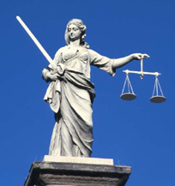
Problem Solving
Often no “right” answer - explore all possibilities
A weighing up of competing factors
Citing cases

Slide 12
Do you want to pass?
In an Australian university learning is YOUR responsibility. It is up to you to be self- disciplined and keep up to date
Begin reading your textbook & lecture notes TODAY
Seek help if you have difficulty writing assessments
Ask your lecturer to explain if you don’t understand something.
Give priority to your study over part time work

Slide 13
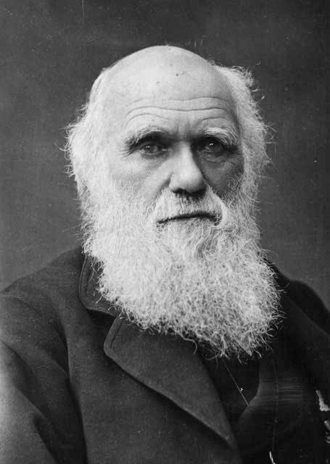
Small Group Discussion
What does English biologist Charles Darwin mean when he says:
It is not the strongest of the species that survive, nor the most intelligent, but the one most responsive to change

Slide 14
Small Group Challenge
Roads and Maritime, the state government department responsible for roads in NSW has a problem.
They want to reduce the number of speeding infringements issued by police to motorists passing through Heathcote, a small suburb on the Princes Highway about 50 mins south of Sydney.
Roads and Maritime seek your advice.
In groups, determine at least two different ways their objective may be achieved.

Slide 15
Evolution
Evolution is a process of formation or growth
Adaptability is the ability to adjust readily to different conditions
Things that cannot adapt and evolve become obsolete

Slide 16
What is the purpose of law?
The law is not static
It is constantly evolving and must be receptive and adaptable to change
The law supports our values and objectives as a society
Our legal system must be able to respond to changing values and objectives by enacting new laws, amending current laws, and repealing old laws

Slide 17
How can you change the law?
Lobby your elected representative
The politicians we elect represent us in parliament
They enact new laws, amend current laws, and repeal old laws
This law is called statute law

Slide 18
How can you change the law?
2. Take your matter to court
Judges modify the law when deciding the outcome of legal disputes
This law is called common law

Slide 19
Common Law & Equity
Common law includes another body of rules called equity
Equity evolved because the strict application of common law principles in the courts was causing unfair outcomes
Equity is based on principles of fairness
It offers plaintiffs a broader range of actions and remedies than common law

Slide 20
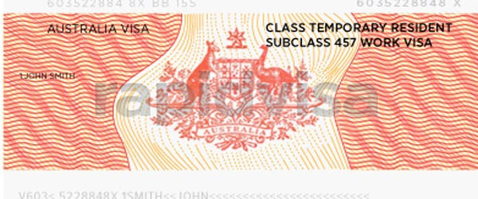
Which laws will you change?
Some current laws and regulations that don’t serve my interests include:
immigration
education
housing
working
??????

Slide 21
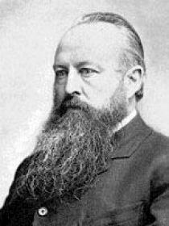
Small Group Discussion
What does English politician Sir John Dalberg-Acton mean when he says:
Power tends to corrupt and absolute power corrupts absolutely

Slide 22
Individual Challenge
1. Create a quiz
Write down three questions on any subject of interest to you
2. Take your quiz
Write down the answers to your questions
3. Assess your performance
Mark your answers and give yourself a score out of 15

Slide 23
Power
The concentration of power into too few people or institutions increases the potential for corruption and abuse of power

Slide 24
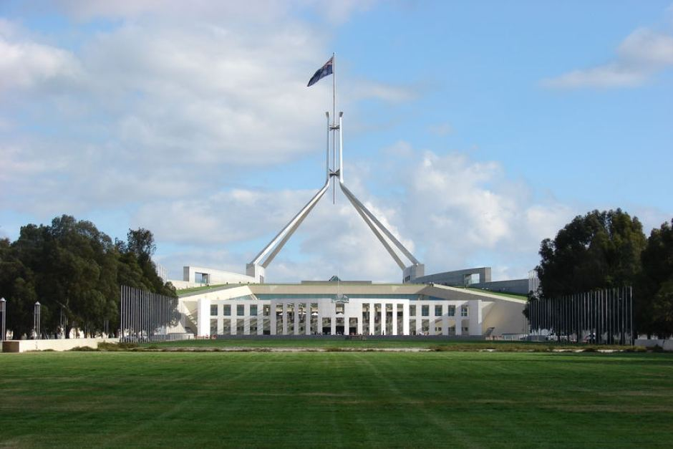
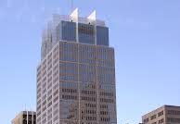
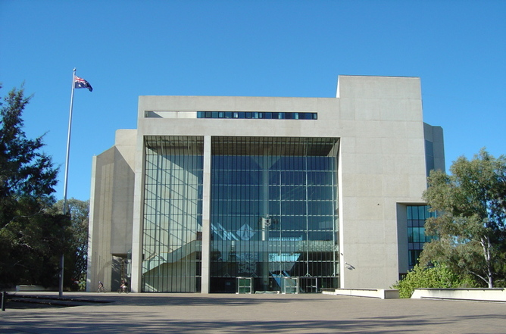
Separation of Powers
Our legal system is a framework for the creation of law, the administration of law, and the adjudication of legal disputes. We separate these three powers and give them to three separate arms of government:
Legislature Executive Judiciary
This is called the principle of separation of power.

Slide 25
Working with the three arms
Let’s say a new tax law is coming in:
the legislature will enact the law – you can lodge a submission or lobby members of parliament to change the proposed new law
the executive will administer the law – you can apply to the Australian Tax Office (ATO) for a tax ruling explaining how they will administer the new law
the judiciary will adjudicate on legal disputes – you can appeal a decision of the ATO to the Administrative Appeals Tribunal (AAT)

Slide 26
How does federation work?
The Australian Constitution provides a list of powers for the Federal Parliament
Some of these powers are exclusive to Federal Parliament such as defence
Most are powers held concurrently with the State Parliaments
Any residual powers not referred to in the Australian Constitution remain with the State Parliaments
Where there is an inconsistency between laws made by the Federal and State Parliaments, the federal law prevails

Slide 27
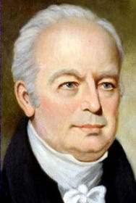
Small Group Discussion
What does US Supreme Court Justice John Rutledge mean when he says:
So long as we may have an independent judiciary, the great interests of the people will be safe

Slide 28
Small Group Challenge
Sydney Management Academy, a training organisation, has an issue.
They have collated the results of a recent student survey on their complaints handling process identifying the following issues:
Complaints are taking far too long to resolve
Students do not know the appropriate person to lodge their complaints with
Complaints are managed in the same way whether they are small, such as unclean toilets, or very serious, such as lecturer misconduct
Resolutions are often inconsistent even when the nature of a complaint is the same
Resolutions are presented as final with no opportunity for review
Sydney Management Academy seeks your advice.
In groups, devise a new complaint handling process that addresses each of the above issues.

Slide 29
Hierarchies
The Australian judiciary is an organisational hierarchy that provides necessary structure to enable:
a system of review by higher bodies of decisions made by lower bodies
specialisation of different bodies based on seriousness of issues
consistency in decision making across the entire organisation

Slide 30
Court Hierarchy
FEDERAL COURTS
STATE COURTS
High Court
Court of Appeal
Federal Court
Family Court
Supreme Court
District Court
Federal Circuit Court of Australia
Magistrates Court
Tribunals
Notes:
Categories of courts The Courts system in Victoria can seem complicated. Because laws are made by both State and Federal governments, and as a result of the Constitution, there are both State and Federal courts and tribunals. Sometimes there might be more than one law involved and so there might be more than one court or tribunal relevant to your situation.
Victorian Courts
Small cases, either involving disputes about small amounts of money (up to $40,000) or less serious crimes, are dealt with in the Magistrates' Court of Victoria. The County Court of Victoria deals with more serious crimes or amounts of money between $40,000 and $200,000. Most appeals from the Magistrates' Court are heard in the County Court. The Supreme Court of Victoria hears very serious criminal cases, such as murder, and also hears cases about large disputes over money and businesses. It can also hear appeals about decisions made in the County Court.
The Court of Appeal is really part of the Supreme Court. It hears appeals from decisions of single judges of the Supreme Court
Federal Magistrates Service
The Federal Magistrates' Service is a Federal court that hears some of the smaller cases that might otherwise go to the Family Court or the Federal Court of Australia. Its jurisdiction includes family law and child support, administrative law, bankruptcy, consumer protection, human rights, privacy law and migration matters. The service shares those jurisdictions within the Family Court of Australia and the Federal Court of Australia. Some work in those jurisdictions will also continue to be done in state courts.
Family Court Divorce cases, and disputes about who should look after children after there has been a break up between two parents, as well as disputes about dividing property after a marriage breakdown, are all heard in the Family Court. The Family Court is a Commonwealth Court.
Federal Court
The Federal Court of Australia looks after a number of Federal law matters such as trade disputes, industrial disputes, bankruptcy, federal anti-discrimination laws, and so on. The Court is a superior court of record and a court of law and equity. It sits in all capital cities in Australia and elsewhere in Australia from time to time. The Court's original jurisdiction is conferred by over 120 statutes of the Australian Parliament. The Court exercises appellate jurisdiction over decisions of single judges of the Court, decisions of the Supreme Courts of the Australian Capital Territory and Norfolk Island, decisions of the Federal Magistrates Service in non-family law matters and certain decisions of Australian State Supreme Courts exercising federal jurisdiction.
High Court Jurisdiction
The Australian Constitution vests two types of jurisdiction in the High Court: original and appellate. One of the High Court's principal functions is to decide disputes about the meaning of the Constitution.

Slide 31
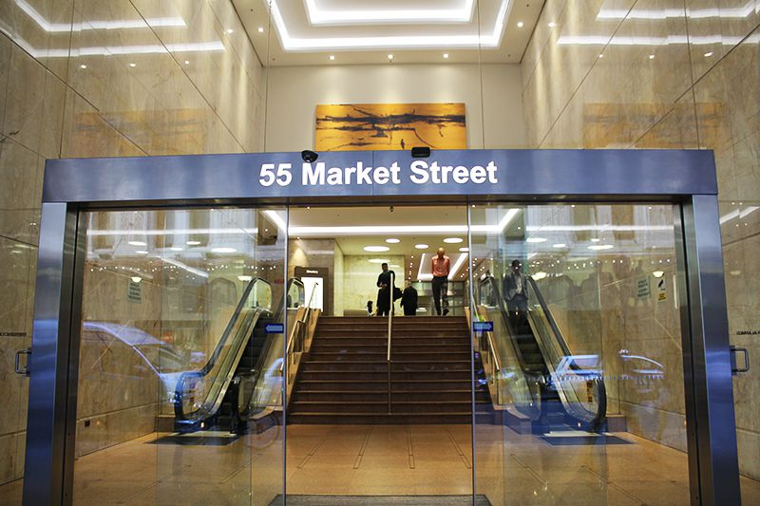
The Australian Judiciary
State Tribunals
hear matters of relatively low importance
lower formality in proceedings
expert panel members
Administrative Appeals Tribunal, Residential Tenancies Tribunal

Slide 32
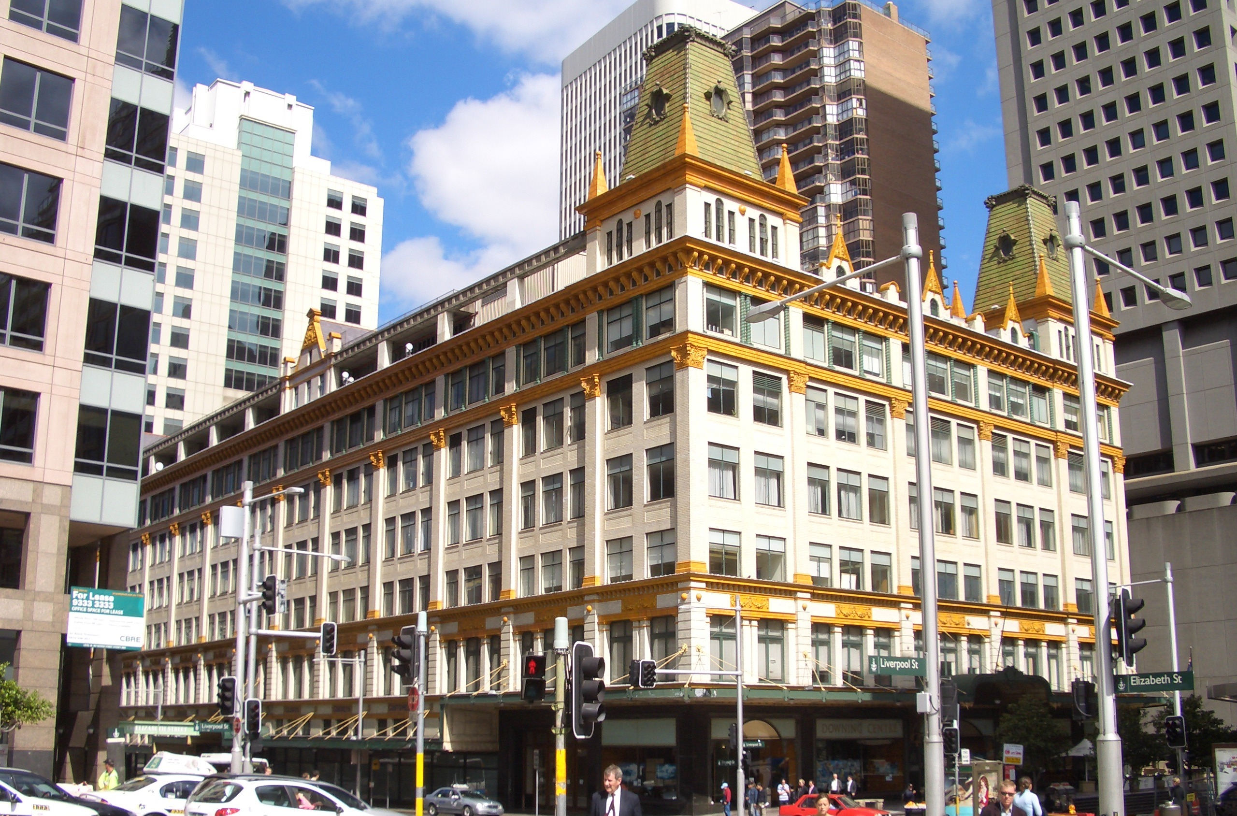
The Australian Judiciary
State Local or Magistrate Courts
hear matters of moderate importance
moderate formality in proceedings
assessors and magistrates
less serious crimes and civil cases up to $100,000

Slide 33
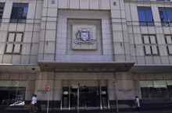
The Australian Judiciary
State District or County Courts
hear matters of importance
formality in proceedings
judges
serious crimes (except murder, treason, and piracy)
civil matters up to $750,000
all motor accident cases

Slide 34
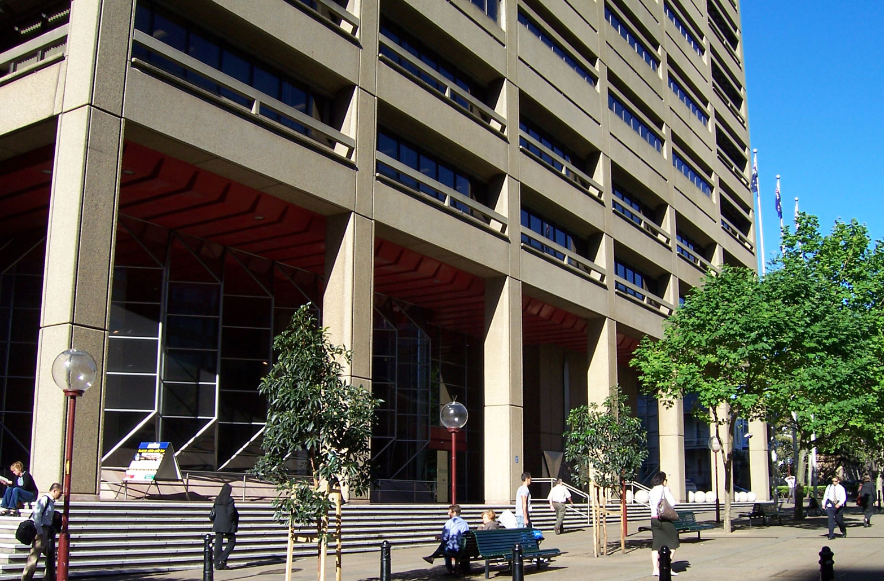
The Australian Judiciary
State Supreme Courts
hear matters of high importance
high formality in proceedings
judges
most serious crimes
unlimited civil jurisdiction

Slide 35
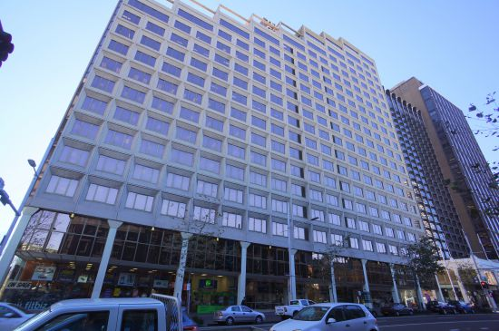
The Australian Judiciary
Federal Circuit Court
hears matters of importance
formality in proceedings
judges
relieves workload of Federal Court and Family Court
matters include bankruptcy, migration, divorces

Slide 36
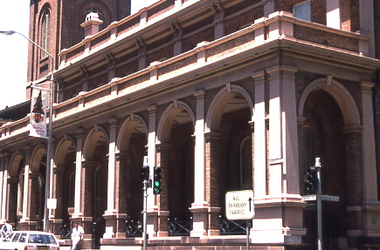
The Australian Judiciary
Federal Court of Australia
hears matters of high importance
high formality in proceedings
judges
matters include trade practices, taxation and civil matters under Federal law

Slide 37
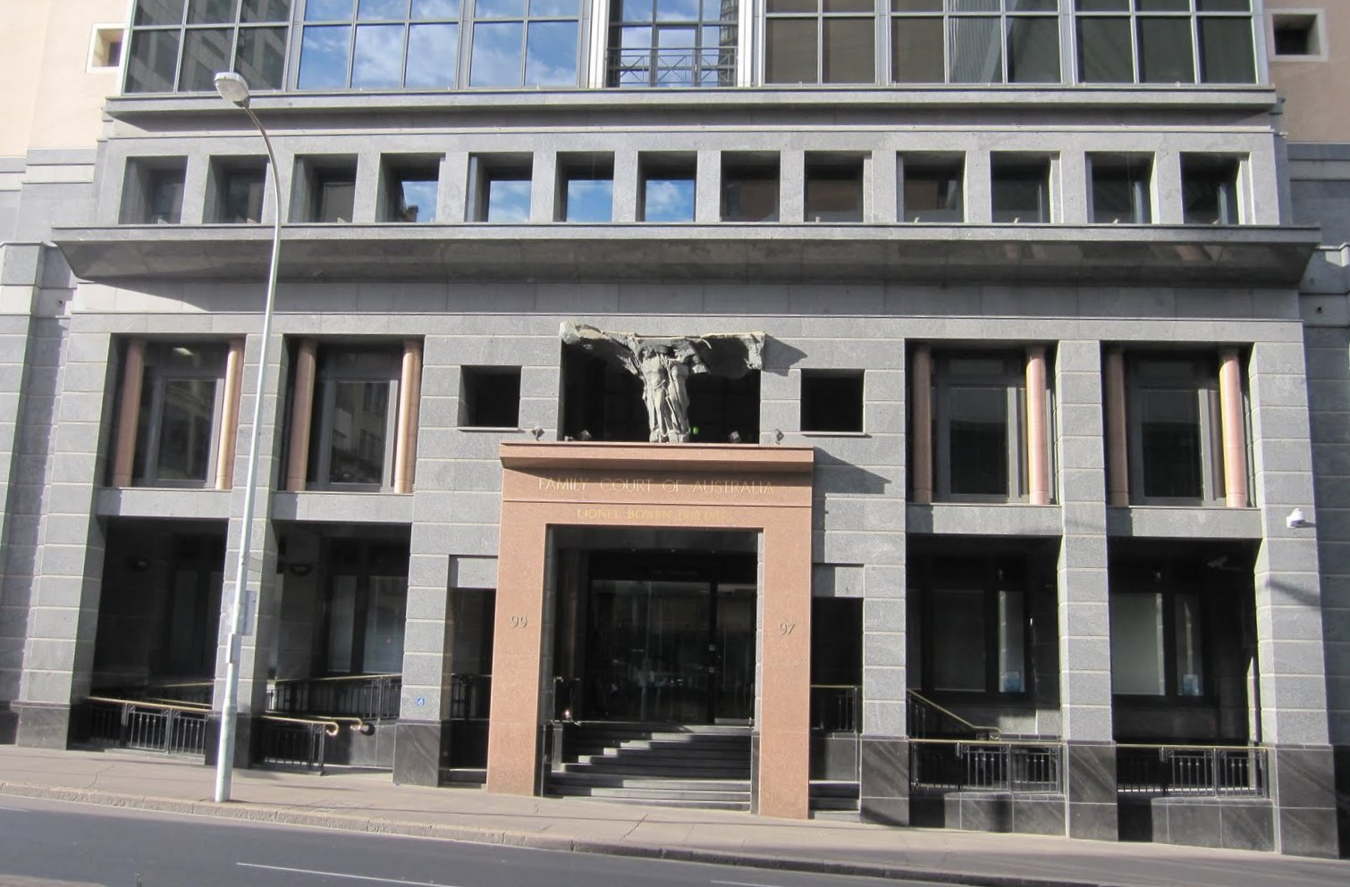
The Australian Judiciary
Family Court of Australia
hears matters of high importance
high formality in proceedings
judges
matters include family violence, parental mental health, child abuse

Slide 38
The Australian Judiciary
High Court of Australia
hears matters of very high importance
very high formality in proceedings
judges
unlimited jurisdiction
appeals against decisions of state Supreme Courts

Slide 39
The Australian Judiciary
Appeals process
you can appeal the decisions of lower courts to higher courts
High Court is the highest court of appeal
appeals move from below upwards

Slide 40
The Australian Judiciary
Precedent
decisions by judges should be consistent
decisions of higher courts are binding on lower courts
decisions of lower courts may be persuasive
precedent moves from above downwards

Slide 41
Constitutional Review
The High Court has the power to review the validity of new Commonwealth legislation to ensure it is enacted under a Commonwealth power in the Constitution
New legislation must be enacted under an exclusive or concurrent power
If the legislation falls under a residual power retained by the states, such as crime or education, it will be unconstitutional and invalid

Slide 42
Precedent
A precedent can be divided into two parts: ratio decidendi and obtier dicta
Ratio decidendi are the judges reasons for the decision and form the binding part of the precedent
Obiter dicta are the ‘sayings by the way’ or judges additional commentary and are only persuasive, not binding

Slide 43
Civil law & Criminal law
Law can also be divided into civil law and criminal law
Civil law matters are brought to court by citizens against other citizens and must be proven on the balance of probabilities
Criminal law matters are brought to court by the police or the Director of Public Prosecutions against alleged offenders and must be proven beyond reasonable doubt

Slide 44
Adversarial system
In court, two opposing parties argue their case before a judge who acts as a neutral third party
The side that has brought the case to court for hearing is called the plaintiff
The side that is defending themselves against the plaintiff’s action is called the defendant
The judges decides whether the plaintiff or the defendant is right and makes court orders in favour of the winning party
The term adversary means opponent which is why this system of court proceedings is known as the adversarial system

Slide 45
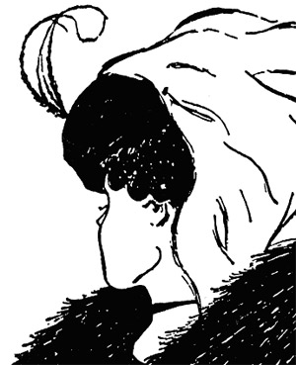
Small Group Discussion
Do you think I’m beautiful?
Notes:
The big idea is subjectivity. The woman in the drawing poses three essential questions designed to foster inquiry, understanding, and transfer of learning.

Slide 46
Small Group Challenge
Imagine that when British cartoonist W.E. Hill published this drawing in Puck humour magazine in 1915 he meant to illustrate for only one interpretation.
That is, he only meant for the woman
to appear young or he only meant for
the woman to appear old. But not both.
In groups, determine at least two
different ways the correct
interpretation could be identified.

Slide 47
Statutory Interpretation
A phrase, a word, and even a gesture can mean something completely different to two different people
Rules of statutory interpretation help us to determine the appropriate meaning of laws written in unclear or ambiguous language
These rules come from common law and statute law

Slide 48
Rules for Interpreting Statutes
Plain meaning rule – read the statute as a whole and if the meaning is plain then look no further
Golden rule – if the plain meaning is absurd look to the meaning that avoids the absurdity and gives effect to the intention of parliament
Mischief rule – look to the mischief that the statute is seeking to overcome
Acts Interpretation Acts – look to the meaning that reflects the intention of parliament

