Slide 1
Contract Law: Essential Elements 1
BUS107 Commercial Law
Week 2 Lecture

Slide 2
Small Group Discussion
What does American political activist Thomas Paine mean when he says:
A body of men holding themselves accountable to nobody ought not to be trusted by anybody

Slide 3
Small Group Challenge
The Australian Political Studies Association has an issue …
They are concerned about the results of a recent public survey identifying politicians as Australia’s least trusted profession. Common reasons for mistrust cited by survey participants allege politicians:
i) fail to keep promises made during their election campaigns; and
ii) say whatever they want in parliament without fear of prosecution because of parliamentary privilege; and
iii) use evasive tactics in media interviews to avoid answering difficult questions.
The Australian Political Studies Association seeks your advice.
In groups, devise a proposal for legislative reform to address each of these three issues.

Slide 4
What is contract law?
The courts apply the principles of contract law to hold promisors accountable for the promises they make
A contract is an agreement that a court will enforce
A contract must meet specific criteria to be a contract otherwise the court will not enforce it

Slide 5
Specific Criteria of a Contract
To be enforceable by a court a contract must have:
offer and acceptance
intention to be legally bound
consideration
capacity of parties
reality of consent
legality of object

Slide 6
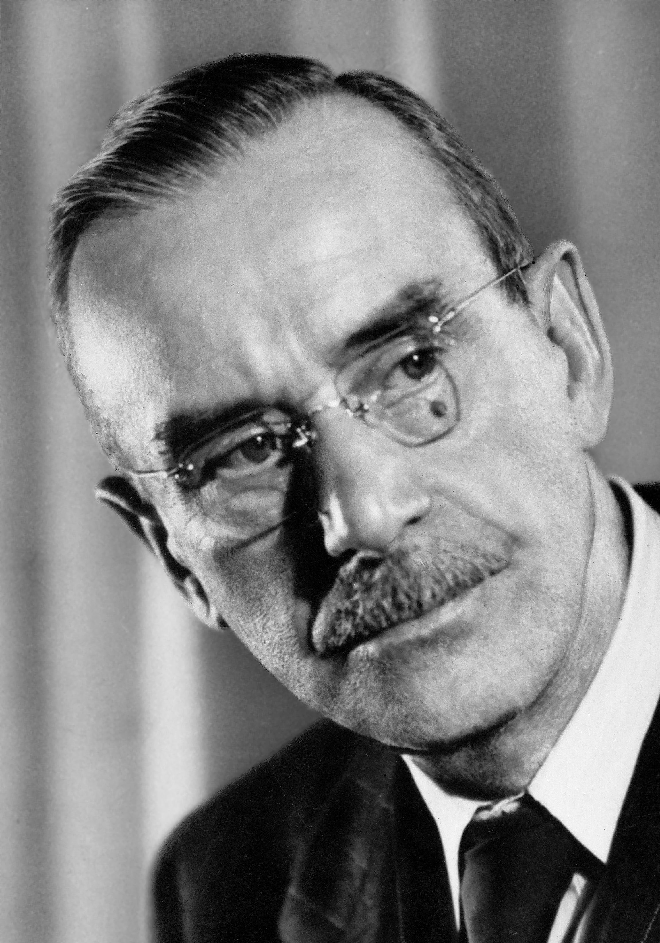
Small Group Discussion
Do you agree with German novelist Thomas Mann when he says:
You ask what is the use of classification, arrangement, systemisation? I answer you: order and simplification are the first steps toward the mastery of a subject – the actual enemy is the unknown

Slide 7
Small Group Challenge
The NSW Department of Justice has a some concerns …
They are trialling a new information hotline to assist people engaged in contractual disputes. An initial review of operations has revealed that call centre staff are regularly giving callers inaccurate advice. Specific examples of bad advice from recorded conversations include:
“Yes, it is an offer. If she told you she might sell you her car then that is an offer.”
“It can still be a contract even if he hasn’t agreed to your offer yet.”
“It doesn’t matter if he didn’t really mean it. An offer is an offer and once he made it he can’t take it back.”
“You made a contract with him from the moment you decided to accept his offer.”
“It’s OK. Just because you agreed to pay $500 doesn’t mean you can’t re-negotiate.”
The NSW Department of Justice seeks your assistance.
In groups, create a system of rules that distinguishes between offer and non-offer, and acceptance and non-acceptance.

Slide 8
Classification
Discrimination also means the act of differentiating between this and that i.e. noting or observing a difference
We can use discrimination constructively to create classification systems and algorithms for mapping processes and facilitating decision making

Slide 9
Offer and Acceptance
To be legally enforceable a contract requires an offer and an acceptance
Offer and acceptance are specific concepts that must meet essential criteria to be recognised at law as an offer or an acceptance

Slide 10
An offer …
must be a firm promise: see Harvey v Facey
must be communicated: see R v Clarke
may be withdrawn prior to acceptance:
see Routledge v Grant
may be made to one person, a group of people, or the entire world: see Carlill v Carbolic Smoke Ball Co
may be terminated by a counter-offer:
see Tinn v Hoffman & Co
is different from an invitation to treat:
see Pharmaceutical Society v Boots

Slide 11
Offer must be a firm promise
Harvey v Facey
Harvey wanted to buy Bumper Hall Pen from Facey. Harvey telegrammed to Facey as follows:
"Will you sell us Bumper Hall Pen? Telegraph lowest cash price..."
Facey replied:
“Lowest price for Bumper Hall Pen £900"
Harvey responded:
“We agree to by Bumper Hall Pen for the sum of £900 asked by you."
The court held that Facey merely supplied factual information as requested. The only offer was made by Harvey which Facey did not accept.

Slide 12
Offer may be withdrawn prior to acceptance
Routledge v Grant
Grant offered to buy Routledge's house. He said he would keep his offer open for six weeks.
Grant withdrew the offer within six weeks and before Routledge had accepted the offer.
This caused Routledge problems as he had bought another house believing that his would be sold.
The court held an offeror was entitled to revoke an offer at any time before it was accepted.

Slide 13
Offer may be made to entire world
Carlill v Carbolic Smoke Ball Co
During an influenza epidemic, a company advertised that it would pay £100 to any person who contracted influenza after purchasing their “Carbolic Smoke Ball" and using it as directed.
Carlill purchased the Carbolic Smoke Ball, used it as directed and still caught influenza. The company refused to pay the £100.
The court held that the company’s advertisement was an offer which Carlill accepted when she purchased the smoke ball.

Slide 14
Offer is different from an invitation to treat
Pharmaceutical Society v Boots
It was illegal to sell certain drugs unless the sale was made by a pharmacist.
The defendant operated a self service chemist shop.
Customers selected their drugs and took them to the checkout located near the exit.
A pharmacist supervised the checkout and approved or cancelled the sale.

Slide 15
Offer is different from an invitation to treat
Pharmaceutical Society v Boots (cont)
If the display of the goods was an offer, then the contract was made when the customer brought the goods to the checkout. An offence occurred.
If the offer occurred when the customer brought the goods to the checkout, then the contract was made when the pharmacist approved the sale. No offence occurred.
The court held that:
The customer made the offer when presenting the item at the checkout counter.
The display of goods amounted to no more than an "invitation to treat".

Slide 16
An acceptance …
must be absolute and unconditional:
see Masters v Cameron
must be communicated:
see Felthouse v Bindley
must be made in reliance of the offer:
see R v Clarke
must be made in accordance with the terms of the offer:
see Gilbert J McCaul Pty Ltd v Pitt Club Ltd
may be forwarded by post and is effective as soon as it is posted:
see Adams v Lindsell

Slide 17
An acceptance must be absolute and unconditional
Masters v Cameron
A signed document prepared by a real estate agent contained this term:
“This agreement is made subject to the preparation of a formal contract of sale which shall be acceptable to my solicitors on the above terms and conditions...“
The document covered all essential terms of a sale including sale price & deposit.
The purchaser refused to proceed.

Slide 18
An acceptance must be absolute and unconditional
Masters v Cameron
The High Court said that
There were three possibilities:
There is a contract which is immediately binding and one other terms is that formal documentation will be prepared.
There is a contract and nothing can happen until a formal contract is prepared.
There is no contract.
Normally an arrangement made "subject contract" is presumed not to be a contract.
There was no evidence in this case to displace the general rule.

Slide 19
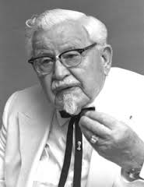
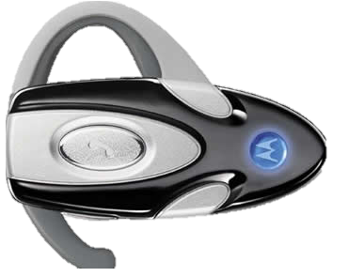
Offer and Acceptance
If I was to sell you my car, I would want $10,000
I would actually sell for $8,000
I would actually buy for $11,000
Hah! Your house for $10,000!
I’ll sell you my car for $9,000
Well, let me think about it …
Wait … $9,500!
$9,250
Sold!
Notes:
Ronald McDonald and Colonel Sanders negotiate the sale of a car:
Ronald’s first statement is not a firm promise – can’t be an offer
The Colonel’s first statement is not made in reliance of the offer – can’t be acceptance
Ronald’s thought bubble is not communicated – can’t be an offer
The Colonel’s thought bubble is not communicated – can’t be acceptance
Ronald’s second statement is an offer
The Colonel’s second statement is not absolute and unconditional – can’t be acceptance
Ronald’s third statement is a new offer made prior to acceptance – it revokes the preceding offer
The Colonel’s third statement is a counter-offer – it revokes the preceding offer
Ronald’s fourth statement is acceptance – a contract is formed

Slide 20
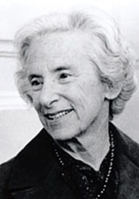
Small Group Discussion
What does American novelist Barbara Tuchman mean when she says:
When truth and reason cannot be heard, then must presumption rule

Slide 21
Small Group Challenge
The NSW Attorney-General is concerned about a recent emerging trend …
People all around the world are taking legal action against their own parents. A daughter in the US has successfully sued her parents for college tuition fees. A son in Taipei is attempting to sue his biological mother for abandoning him when he was a baby.
The NSW Attorney-General believes cases like this may give rise to a new wave of litigation between parents and their sons and daughters. Specifically, he worries about people applying the principles of contract law to sue their parents for not honouring social agreements over matters like allowance payments and university fees.
He understands though that some agreements between family members are more commercial in nature and definitely should be enforceable in court.
The NSW Attorney-General seeks your advice.
In groups, devise at least two suggestions for law reform that would prevent people from suing their parents over broken social agreements but preserve their right to sue their parents for breach of commercial agreements.

Slide 22
Presumptions
A presumption is a starting position to be either confirmed or rebutted by evidence of the true position
An important example: if you are charged with a crime you are presumed innocent until proven guilty

Slide 23
Intention to be legally bound
For a contract to be enforceable the parties must intend to be legally bound
The courts consider the nature of the relationship between the parties and draw a distinction between social agreements and commercial agreements

Slide 24
Social agreements
The courts presume that parties to a social agreement do not intend to be legally bound but this presumption can be rebutted by evidence the contrary:
see Balfour v Balfour

Slide 25
Social agreements
Balfour v Balfour
The facts:
Mr Balfour promise to pay his wife £30 per month as he had to return his job in Ceylon while she stayed in England.
The couple later separated
Mrs Balfour claimed £30 per month.
The court held that:
An agreement existed but the parties had not intended it to be legally binding.
Generally, domestic arrangements of this type were not intended to finish up in court.

Slide 26
Commercial agreements
The courts also presume that parties to a commercial agreement do intend to be legally bound but this presumption can be rebutted by evidence to the contrary:
see Rose & Frank Co v JR Crompton & Bros

Slide 27
Commercial agreements
Rose & Frank Co v JR Crompton & Bros
The facts:
An English company agreed to appoint Rose and Frank as its exclusive US distributors of paper tissue products.
The agreement included the following term:
“This arrangement is not entered into, nor is this memorandum written, as a formal or legal agreement, and shall not be subject to legal jurisdiction in the law courts either of the United States or England, but it is only a definite expression and record of the purpose and intention of the three parties concerned to which they each honourably pledge themselves with the fullest confidence, based on past business with each other, that it will be carried through by each of the three parties with mutual loyalty and friendly cooperation."
The court held:
The parties intention not to create legal relations had been made abundantly clear by this term.
Therefore there was no contract.

Slide 28
Small Group Discussion
Do you agree with Irish playwright Oscar Wilde when he says:
Nowadays people know the price of everything and the value of nothing

Slide 29
Small Group Challenge
Oxfam, a global development charity against poverty and injustice has an issue …
They are considering a new fundraising initiative using social media. The objective is to create a viral pledge drive using Facebook, Twitter, and Instagram.
A potential risk identified by senior management is that public pledge drives are notorious for failing to reach their fundraising targets. The problem is that many people agree to donate but later renege on their promise when followed up.
Oxfam seeks your advice.
In groups, devise at least two strategies Oxfam could implement to bind people to their pledges and prevent them from reneging on their promises to donate.

Slide 30
What is value?
Value is a relative concept and so contract law does not require the items of exchange in a contract to have equal or similar value
What contract law does require is that items are exchanged for something of value called consideration

Slide 31
Consideration defined
In the case of Dunlop Pneumatic Tyre Co v Selfridge & Co consideration was defined as follows:
“An act or forbearance of one party, or the promise thereof, is a price for which the promise of the other is bought; and the promise thus given for value is enforceable.”

Slide 32
Consideration
Consideration is necessary for a contract to be legally binding
Consideration given by purchasers to vendors is almost always money but does not have to be
Consideration must have legal value but need not be of adequate value:
see Chappell & Co Ltd v Nestle Co Ltd

Slide 33
Consideration must not be past
Roscorla v Thomas
The plaintiff purchased a horse from the defendant.
After the sale the plaintiff asked if the horse was sound and free from vice.
The defendant assured him it was.
In fact, the horse was "very vicious, restive, ungovernable and voracious".
The plaintiff sued for breach of contract.
The court held that:
The assurance was given after the contract for the sale of the horse was completed
There was no additional consideration for the assurance.
The assurance was not part of any contract.

Slide 34
Consideration must be sufficient
Stylk v Myrick
The facts:
A seaman signed on for a voyage from London to the Baltic and back.
During the voyage 2 of the 11 crew deserted.
The captain promised the remaining crew that they could have the wages of the two deserters if they completed the voyage.
When the ship arrived in London, the captain refused to pay the extra wages.
The court held that:
The captain's promise was not supported by consideration as the crew were already under a contractual duty to complete the voyage which included extra duties required in an emergency.
The semen were not entitled to the extra wages.

Slide 35
Promissory Estoppel
In some cases it would be unfair for the court to not enforce a promise made even though no consideration has been provided and no contract exists
A tenant that promises to enter a commercial lease once the property is renovated will be held accountable to that promise even though no contract exists:
see Walton Stores (Interstate) Ltd v Maher
& Central London Property Trust Lt v High Trees House Ltd

Slide 36
Promissory Estoppel
Central London Property Trust Lt v High Trees House Ltd
In 1937 the plaintiff leased a block of flats in London to the defendant for £2,500 per year.
In 1940 the plaintiff agreed to reduce the rent to $1,250 because the defendant was unable to let many of the flats due to the Second World War.
By 1945 the flats were fully let and the plaintiff claimed the full rent again.
The court held that the plaintiff was estopped from claiming the back rent.

Slide 37
Promissory Estoppel
There are six requirements for promissory estoppel to apply:
Promisee assumed a legal relationship with promisor
Promisor was responsible for the assumption
Promisee relied on the assumption
Promisor intended for promisee to rely on the assumption
Promisee suffers detriment because of reliance
Promisor has failed to warn promisee

Slide 38
Problem
Jerry is addicted to soccer. His favourite team is Liverpool FC. So he invented a new program to track and predict soccer scores.
Every betting company in the world wanted the exclusive use of the program. Ben, who is the CEO of Ulose, offers Jerry a lifetime pass to all Liverpool FC matches in return for exclusive use of the program.
Shortly after he enters this contract with Ulose, Jerry is diagnosed with Motor Neurone disease which means that he cannot travel from Australia to England to attends Liverpool FC matches. Jerry is devastated. He telephones Ben and says:
“The deal is off! The contract is not binding because I didn’t intend to be legally bound and because you didn’t provide money consideration in exchange for my program. A lifetime pass to soccer matches is not adequate consideration. I want a new deal. I want $5 million.”
Ben says “no” and hangs up the phone.
Advise Jerry if he can demand a new contract from Ben. Use the:
Issue – Rule – Application – Conclusion
method to structure your advice.

