Slide 1
Contract Law: Essential Elements 2
BUS107 Commercial Law
Week 3 Lecture

Slide 2
Small Group Discussion
Do you agree with English playwright William Shakespeare when he says:
Love is too young to know what conscience is

Slide 3
Small Group Challenge
The Australian Defence Forces have a problem…
The Office of the Special Representative of the Secretary-General for Children and Armed Conflict has written a formal letter of protest against the Australian government for recruiting minors into the armed forces.
A person aged 17 years of age can apply to serve so long as their application is voluntary and approved in writing by a parent or guardian. The Australian Defence Forces state that they abide by the spirit and intent of the Optional Protocol on the Rights of the Child in Armed Conflict. They also say they will take all feasible measures to ensure that minors do not participate in hostilities, however there may be times when they may have to.
The UN Secretary-General believes this is unacceptable and want the Australian Defence Forces to raise the minimum recruitment age to 18.
In groups, decide whether or not it is morally right for the Australian Defence Forces to recruit minors and explain why

Slide 4
Capacity to Agree
Legal capacity is a person’s authority under law to engage in a particular activity
Until a person has reached a certain age the law deems they lack the ability or capacity to agree to certain activities

Slide 5
Capacity in Contracts
You can’t agree to be bound by a contract if the law deems you lack the capacity to agree
Minors, intoxicated people, and the mentally unsound are all deemed to lack capacity to enter contracts
Minors sometimes need to be able to enter contracts such as a contract of employment, so the law does provide some exceptions

Slide 6
Contracts binding on minors
Minors will be bound by contracts for necessaries under the common law: see Nash v Inman
Minors will be bound by beneficial contracts of service:
see De Francesco v Barnum
Legislation in NSW binds minors to contracts if they understand what they are doing and their contract is for their benefit: see ss.17-19 Minors (Property and Contracts) Act 1970 (NSW)

Slide 7
Nash v Inman
A minor purchased a number of fancy waistcoats from a tailor and then refused to pay
As the buyer was a minor, the issue was whether the contract was a contract for the purchase of necessaries.
The court held that:
Even if a waistcoat could be described as a necessary, in this case the minor already had an adequate number of waistcoats
The contract was not a contract for necessaries.
The Minor was not legally bound by the agreement.

Slide 8
De Francesco v Barnum
A 14 year old minor entered into a contract of apprenticeship with a Choreographer.
The contract stated that the minor could not:
Take any paid work
Marry.
The minor received payments for performances arranged by the Choreographer but there was no guarantee that the choreographer would organize performances.
The court held that:
If there are too many detriments in the contract then it is not a contract for beneficial services.
The contract was not for the benefit of the minor.

Slide 9
Minors (Property and Contracts) Act 1970 (NSW)
s18 - Age of understanding
A minor is not bound by a contract if, by reason of youth, they lack the understanding necessary for his or her participation in the contract.
s19 - Beneficial civil act
If a minor participates in a contract which is not for his or her benefit at the time, the contract is presumed not to be binding on the minor.

Slide 10
Capacity of corporations
A company is a legal person in the same way as a natural person is a person
When a company has the legal capacity to enter contracts
s.124 Corporations Act 2001 (Cth)
(1) A company has the legal capacity and powers of an individual both in and outside this jurisdiction. …

Slide 11
Small Group Discussion
What does British journalist Dorothy Richardson mean when she says:
Coercion.
The unpardonable crime

Slide 12
Small Group Challenge
The Commonwealth Bank has a problem …
A business client with no assets has defaulted on his loan. Luckily, his bank manager secured a personal guarantee from the businessman’s parents. The parents own their home which the bank now wants to take to repay the loan.
The parents are refusing to surrender their home for these reasons:
i) The parents are elderly immigrants from Italy that do not understand English well and did not realise their home could be taken to repay their son’s loan;
ii) The bank manager knew this and did not offer to provide them an interpreter or recommend they seek independent legal advice before signing the guarantee;
iii) The parents mistakenly believed their son’s business was doing very well;
iv) The bank manager knew the son’s business was failing.
The Commonwealth Bank seeks your advice.
In groups, prepare a letter to the bank explaining whether or not you believe the parents are bound by the guarantee.

Slide 13
Reality of consent
Even if you have the capacity to agree to be bound to a contract there are some circumstances where your agreement cannot really be said to be agreement
Agreement is not legally binding if it is forced or coerced from you, or if you are deceived into agreeing
The contract will be voidable at the option of the innocent party

Slide 14
Reality of Consent
Reality of consent will not be present if there is:
Duress
Undue Influence
Unconscionable Conduct
Misrepresentation

Slide 15
Duress
You cannot threaten someone to force them to enter a contract
Barton v Armstrong
Normal commercial pressure is not duress
Electricity Generation Corporation v Woodside Energy Ltd

Slide 16
Barton v Armstrong
Armstrong was the chairman and held the largest sharing holding in Landmark Corporation Ltd a public company.
Barton was the managing director and also had a substantial shareholding.
There was a long history of ill will between the parties and a struggle over the controlling power.
Barton and the other 2 directors managed to cancel all credit facilities forLandmark Corp.
When Armstrong discovered the credit had been cancelled he threatened to kill Barton to pressure him into signing an agreement to purchase Armstrong's shares in the company at a substantial over value.
Barton agreed due to the threats, the fact Armstrong would no longer have controlling interest and his belief that he could turn the company around.
The company became insolvent and Barton sought to have the contract set aside.
The court held:
There was no obligation to show that Barton would not have entered the agreement but for the threat, it was sufficient that the death threats were a cause.
The contract was void.

Slide 17
Undue Influence
A contract is unenforceable if it has been entered because of Undue influence
Allcard v Skinner

Slide 18
Allcard v Skinner
Miss Skinner was the head of a religious order named "Protestant Sisters of the Poor".
Miss Allcard joined the order and had to observe vows of poverty and obedience.
Miss Allcard gave all her railway shares to Miss Skinner.
Allcard claimed the money back after she left the order.
The court held:
“What then is the principle? Is it that it is right and expedient to save persons from the consequences of their own folly? Or is it that it is right and expedient to save them from being victimised by other people? In my opinion the doctrine of undue influence is founded upon the second of these two principles. …
It would obviously be to encourage folly, recklessness, extravagance and vice if persons could get back property which they foolishly made away with, whether by giving it to charitable institutions or by bestowing it on less worthy objects.
On the other hand, to protect people from being forced, tricked or misled in any way by others into parting with their property is one of the most legitimate objects of all laws; and the equitable doctrine of undue influence has grown out of and been developed by the necessity of grappling with insidious forms of spiritual tyranny and with the infinite varieties of fraud.”

Slide 19
Electricity Generation Corporation v Woodside Energy Ltd
Long term gas supply agreement
Sellers obliged to use "reasonable endeavours" to supply gas
Sellers allowed to take into account all "relevant commercial, economic and operational matters" in determining whether able to supply gas
Gas explosion at plant operated by third party temporarily reduced supply of gas to market
Sellers refused to supply gas at price stipulated in agreement during period of reduced supply
Sellers offered to supply equivalent quantities of gas at higher price under separate short term agreements
Court held that:
Seller had not breached obligation to use "reasonable endeavours" to supply gas.
Higher price not obtained by duress but normal commercial pressure

Slide 20
Unconscionable Conduct
You cannot take advantage of someone in a position of ‘special disadvantage’ when arranging contracts
People with a special disadvantage include the elderly and people with poor understanding of the English language
Contracts entered under these circumstances are unenforceable: see Commercial Bank of Australia v Amadio

Slide 21
Commercial Bank of Australia v Amadio
The Amadios were:
Elderly Italians who understood little English.
Thought their son’s business was successful but it was insolvent.
Relied solely upon the domineering influence of their son.
The bank required them to sign a guarantee and mortgage of their house to secure their son’s overdraft.
The bank manager was aware that the son’s business was insolvent and the son had influence over his parents.
The bank manager should have been aware that the Amadios did not understand the guarantee.
The bank manager did not advise the Amadios to obtain independent advice.
The son’s business collapsed and the bank called up the guarantee.

Slide 22
Commercial Bank of Australia v Amadio
The court held that it had power to set aside agreements where:-
A party to the transaction was under a special disability in dealing with the other party with the consequence that there was an absence of any reasonable degree of equality between them; and
The disability was sufficiently evident to the stronger party to make it unfair to accept the weaker party’s consent to the transaction.

Slide 23
Misrepresentation
A false statement made to induce somebody to enter a contract
Misrepresentation can be:
fraudulent – where the statement is intentionally deceptive: see Derry v Peek
innocent – where the statement is not intentionally deceptive
negligent – where the statement is made recklessly: see Hedley Byrne & Co Ltd v Heller and Partners Ltd

Slide 24
Derry v Peek
A Tramway company's prospectus stated that the company had permission to use steam trams, rather than horse powered ones.
In fact, it did not because the right to use steam power was subject to the Board of Trade's consent.
The company applied, honestly believing that they would get it because permission was a mere formality.
In fact, after the prospectus was issued, they did not get permission.
Shareholders who had purchased their stakes in the company on the faith of the statement, sued when the company's business ended up in liquidation.

Slide 25
Derry v Peek
The court held that the shareholders' action failed because it was not proved that the director lacked an honest belief in what they had said.
Although unreasonableness of the grounds of belief is not deceitful, it is evidence from which deceit may be inferred. There are many cases, "where the fact that an alleged belief was destitute of all reasonable foundation would suffice of itself to convince the court that it was not really entertained, and that the representation was a fraudulent one."

Slide 26
Hedley Byrne & Co Ltd v Heller and Partners Ltd
An advertising agency asked for a reference for a potential customer from the customer's bank.
The customer's bank gave the reference with the disclaimer:-
“Confidential. For your private use and without responsibility on the part of the bank or its officials.”
The advertising agency relied on the reference, gave credit to the customer and lost a considerable amount of money.
The court held that:
A person giving advice could owe a duty of care to the recipient to take reasonable care in providing that advice if a special relationship existed between them.
No special relationship existed because the customer's bank provided the reference with a disclaimer.

Slide 27
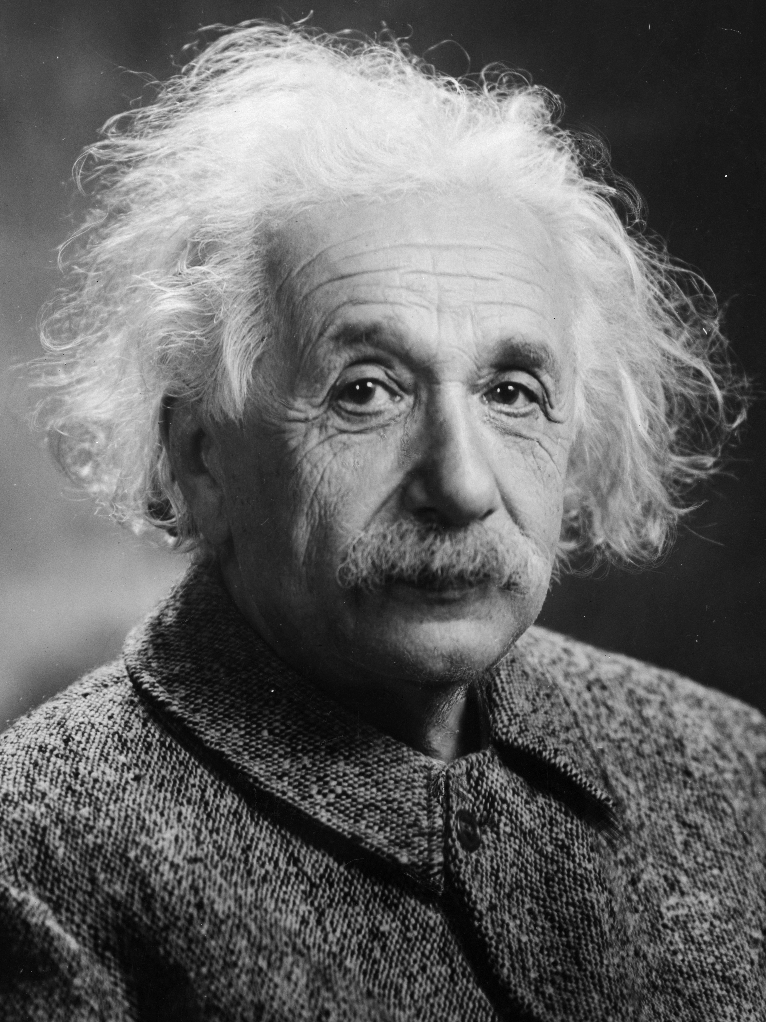
Small Group Discussion
Do you agree with German physicist Albert Einstein when he says:
It is my conviction that killing under the cloak of war is nothing but an act of murder

Slide 28
Small Group Challenge
The Local Council of Sydney has an issue…
The Council is being sued by a major real estate developer for not approving the development of a five storey unit complex in the Surry Hills district.
The developer claims that the Town Planner responsible for reviewing the application agreed to approve the development in exchange for expensive gifts and cash payments.
The developer honoured this agreement by supplying the gifts and cash and wants to sue the Town Planner and the Council for failing to fulfil their part of the bargain.
The Local Council of Sydney seeks your opinion.
In groups, prepare a short brief advising the Council on the likely outcome of the dispute.

Slide 29
Killing and murder
Killing a person is legal if you are acting in self-defence, executing a convicted criminal on the government’s behalf, or fulfilling law enforcement or armed forces duties
Beyond these circumstances, killing another person is illegal and any contract to perform a killing or any other illegal activity is not enforceable

Slide 30
Legality of Object
Some contracts, although possessing all the formal requirements of valid contracts, will be void because the object of the contract is one which is not allowed, or is discouraged by law:
see Pham v Doan

Slide 31
Pham v Doan
A partnership in a pharmacy was illegal under the legislation because it included a non-pharmacist and therefore the partnership agreement was unenforceable.
A contract may be legally formed, and still be classified as illegal if it is for an illegal purpose or is performed in an illegal manner

Slide 32
Small Group Discussion
Do you agree with Andalusian poet Solomon Ibn Gabirol when he says:
As long as a word remains unspoken, you are its master; once you utter it you are its slave

Slide 33
Small Group Challenge
The NSW Law Reform Commission, which reviews the law in NSW and makes recommendations for change to the Attorney General, has a problem …
The Commission is currently considering how some promises ultimately become contractual terms, that is commitments giving rise to rights and obligations between parties, and some don’t.
The Commission has specifically identified six kinds of promises:
i) A promise made during negotiations but not included in the written contract;
ii) A promise that a party did not read before signing the contract;
iii) A promise that one party will not be sued by the other if they breach the contract;
iv) A promise made after the contract has already been signed;
v) A promise to act in good faith even though neither party agreed to do so;
vi) A promise both parties forgot to include rendering the entire contract unworkable.
The Commission seeks your assistance.
In groups, prepare a short brief to the Commission recommending whether or not each of the above promises should become contractual terms and why.

Slide 34
Express vs Implied Terms
Contracts often contain multiple promises between the parties that we call terms
Some terms are express, that is they are explicitly written or spoken as being part of the contract by the parties themselves
Some terms are implied, that is they are not explicitly written or spoken but are put into the contract by legislation or sometimes by the conduct of the parties

Slide 35
Express Terms in Writing
The courts will presume that a written contract which appears complete on its face contains the whole agreement and will not permit a party to add to or vary or contradict the written agreement
This presumption can be rebutted if evidence clearly indicates the contract is not complete
This is called the parol evidence rule

Slide 36
Implied Terms
Let’s say you buy a mobile phone that turns out to be a dud
You take it back to the shop but the salesman refers you to the contract and points out that nothing in there actually says that the phone has to work
At common law there is a term implied into contracts for the sale of goods that the goods be of ‘merchantable’ quality, that is, they work
Legislation would also cover you with a statutory guarantee under the Australian Consumer Law

Slide 37
Post Contractual Statements
As a general rule, contracts you sign are binding even if you did not read the contract: see L’Estrange v Graucob
But you cannot be bound by statements, promises or representations made after the contract has been formed:
see Olley v Marlborough Court
These are called post contractual statements

Slide 38
L’Estrange v Graucob
The plaintiff signed a sales agreement for a machine which contained an exemption clause "in regrettably small print but quite legible" which read:-
“This agreement contains all the terms and conditions under which I agree to purchase the machine specified above and any express or implied condition, statement or warranty, statutory or otherwise, not stated herein is hereby excluded.”
The vendor did not take any steps to bring the clause to the attention of the purchaser.
The purchaser was aware of the nature of the document she was signing but had not read it.
The machine failed.
The court held that:
The purchaser had signed the agreement and therefore was bound by it.
It was irrelevant that she had not read it and was unaware of the term.

Slide 39
Olley v Marlborough Court
The plaintiffs booked & paid for a hotel room for a week.
When they got to their room, they noticed a sign on the back of the door which said:-
The proprietors will not hold themselves responsible for articles lost or stolen unless handed to the manageress for safe custody.
The plaintiff’s furs were stolen as a result of the carelessness of hotel’s staff.
The court held that:
The Hotel could only rely on the exclusion clause if it was a term of the contract.
The contract was made at the reception desk before the plaintiff went to her room.
Therefore the exclusion clause was not a term of the contract.

Slide 40
Exemption Clauses
Sometimes a contract will include a term that limits or excludes the liability of one of the parties
These terms are called exemption clauses or exclusion clauses
The courts presume that parties do not intend to exclude liability for a fundamental breach of the contract

Slide 41
Conditions vs Warranties
A condition is an important term of the contract
A breach of condition gives the innocent party the right to terminate the contract and sue for damages
A warranty is a less important term of the contract
A breach of warranty give the innocent party the right to sue for damages, but not terminate the contract: see Bettini v Gye

Slide 42
Bettini v Gye
The plaintiff hired the defendant to sing at concerts from 30 March 1875 to 13 July 1875.
The contract stated that the plaintiff “agrees to be in London without fail at least six days before the commencement of his engagement for the purpose of rehearsals".
Owing to illness the plaintiff did not arrive in London until 28 March 1875.
The defendant terminated the contract.
The court held that
The defendant could only terminate if the time stipulation was a condition.
Whether it was a condition could only be judged by looking at the contract as a whole to see whether the parties had intended the time stipulation to be the root of the contract, the essence of the contract, the heart of the contract.
If the contract had been for a very limited number of performances, the six-day rehearsal period may have been an essential part of the bargain.
However, the contract was for an extensive period and the Time stipulation was not so important as to amount to a condition.

Slide 43
Problem
You are the manager of a mobile phone shop
Ben, who is a 17 year old high school student, comes to the shop and asks to buy a PAYG phone for $50 so he can ring his parents in an emergency.
You get Ben to buy a iPhone 10 on a 2 year contract for $100 per month by threatening to tell his parents that you saw him smoking marijuana
Ben’s mother (Prudence) comes to the shop the next day and returns the phone
Prudence says that Ben is not bound by the contract as he is just a child and he was forced by your threats into buying it.

Slide 44
Issue 1
Issue
Prudence says that Ben is not bound by the contract as he is a child.
Rule
For a contract to be legally binding the parties must have capacity to enter contracts. Minors, intoxicated people, and the mentally unsound are all deemed to lack capacity to enter contracts. Such contracts are voidable at the option of the party lacking capacity.
Minors will, however, be bound by contracts for necessaries under the common law: see Nash v Inman. Legislation in each state modifies this position. For example, in NSW minors are bound to contracts if they understand what they are doing and the contract is for their benefit: see ss.17-19 Minors (Property and Contracts) Act 1970 (NSW).
Application
Ben is17 years of age and therefore a minor. The law deems him to lack the capacity to enter into a long term contract. It is highly unlikely the court will find the mobile phone is either a necessary under common law or is for the minors’ benefit under state legislation as it is far too expensive and fancy (Nash v Inman).
Conclusion
Ben is not bound by the contract. The contract is voidable at Ben’s option.

Slide 45
Issue 2
Issue
Prudence says that Ben is not bound by the contract because you threatened him.
Rule
For a contract to be legally binding there must be reality of consent. This means that you cannot threaten someone to force them to enter a contract. A contract is unenforceable if it has been entered because of duress: see Barton v Armstrong.
The contract will be voidable at the option of the innocent party.
Application
You threatened to report Ben to his parents for smoking marijuana in order to force him to sign the contract. He entered the contract under duress.
Conclusion
Ben will not be bound by the contract. The contract is voidable at his option.

