Slide 1
Contract Law: Termination & Remedies
BUS107 Commercial Law
Week 4 Lecture

Slide 2
Small Group Discussion
Do you agree with American comedian Louis C.K. when he says:
Divorce is always good news. I know that sounds weird but it’s true because no good marriage has ever ended in divorce.

Slide 3
Small Group Challenge
The Liberal Party has a problem …
The Party is busy preparing for the upcoming election. They are troubled by the growing popularity of Family Unity, a new political party that believes marriage failure and family breakdown are responsible for society’s worst problems. Family Unity promise, if elected, to implement legislative reform declaring all present and future marriages permanently binding. They have challenged the major political parties to a TV debate.
The Liberal Party seeks your assistance.
In groups, prepare a brief debating why marriage should be capable of termination, not be permanently binding. Include at least three scenarios or case examples in support.

Slide 4
Is a marriage a contract?
Marriage is a social agreement between two people that can end for a variety of reasons
The law should facilitate the termination of a marriage when termination is necessary
Contractual relationships, like marriages, can become unworkable and must be capable of termination in a way that does not infringe upon the contractual rights of one or both parties

Slide 5
How do contracts end?
Performance
Agreement
Frustration
Operation of law
Lapse of time
Breach of contract

Slide 6
Performance
A contract usually comes to an end when each party has performed the obligations imposed by the contract
Obligations under the contract must be performed exactly, usually near enough is not good enough: see In re Moore & Co Ltd and Landauer & Co

Slide 7
Re Moore & Co Ltd v Landauer & Co [1921] 2 KB 519
The contract called for the sale and delivery of canned fruit packed 30 tins to the case.
Half the consignment was packed 24 tins to the case.
The buyer refused to accept delivery of any of the goods.
The court held that
The requirement that the goods be packed 30 tins to the case was part of the description.
Therefore, there was a breach of the condition that the goods must correspond with the description by which they were sold.
As it was breach of a condition, the buyer was entitled to reject the complete assignment.

Slide 8
Agreement
Parties to a contract can agree to terminate the contract
One party may also waive performance of the contract by not insisting on strict compliance

Slide 9
Frustration
A contract can be terminated by frustration which means a supervening event beyond the control of the parties has made the contract incapable of performance:
see Taylor v Caldwell
A contract will not be frustrated because a party regrets their commitment, or faces hardship, inconvenience, or material loss: see Davis Contractors Ltd v Fareham Urban District Council

Slide 10
Taylor v Caldwell (1863) 122 ER 309
Taylor hired a concert hall from Caldwell.
The hall burnt down prior to the performance.
Taylor sued Caldwell for damages.
The court held that:
the contract was discharged for frustration and, therefore, Taylor could not get damages.

Slide 11
Davis Contractors Ltd v Fareham Urban District Council [1956] AC 696
Davis won a tender to build 78 houses to be completed in eight months.
Due to a serious shortage of labour, it took Davis 22 months to complete the job at an additional expense of £17,500.
Davis claimed that the shortage of labour frustrated the contract.
The court held that:
The contract had not been frustrated.
The delay caused by the labour shortage was foreseeable.
A contract is not frustrated just because one party is commercially disappointed with the outcome.

Slide 12
Operation of law
Certain rules of law can also bring about the termination of a contract such as:
bankruptcy
death
material alteration
merger
Notes:
If one party materially alters a written contract without the knowledge or consent of the other party then the other party can treat the contract as discharged.
Death operates to terminate an offer
Merger of lesser agreement into a greater agreement: is where parties to a simple contract enter into a formal contract or deed, and the simple contract has been merged by the formal contract which has become enforceable. Merger may also operate in such a way where the obligations under the agreement will have the effect of discharge.

Slide 13
Lapse of time
A contract may also be discharged by the passage of time
State legislation provides that a right to sue for breach of contract must be enforced within a fixed period or else it becomes statute barred

Slide 14
Breach of contract
If one party breaches the contract, the other party can “walk away” from the contract and treat their obligations under the contract as finished
A breach may be an actual breach or an anticipatory breach: see Foran v Wight

Slide 15
Foran v Wight (1989) 168 CLR 385
The Forans agreed to buy a property from the Wights.
The Forans were unable to arrange finance but advised the Wights two days before settlement that they would proceed with the purchase.
Two days before settlement the Wights advised the Forans that they would not be able to settle.
Neither party attempted to settle on the settlement date.
Two days later the Forans terminated the contract because of the Wights failure to complete the sale on the settlement date.
The Forans sued for return of the deposit.
The Wights countersued for damages for breach of contract.

Slide 16
Foran v Wight (1989) 168 CLR 385
The court held that
The Wights failure to settle on the settlement date was a breach of condition because the settlement date was "of the essence of the contract".
This entitled the Forans to terminate the contract.
The Forans, although still having difficulty with their finance, were ready and willing to settle.
Therefore, the Forans were entitled to the return of their deposit.

Slide 17
Small Group Discussion
What does French playwright Moliere mean when he says:
Most men die of their remedies, not of their diseases

Slide 18
Small Group Challenge
E-Bling, a new, members only online marketplace for buying and selling new and used luxury items from boutique watches to private jets has a problem …
E-Bling members must agree to submit any dispute to the E-Bling Review Committee for resolution which are binding and typically end with a Committee order for one party to pay the other monetary compensation. In the last fortnight some problematic disputes have come before the Committee:
i) A seller is refusing to honour his contract to sell his rare, solar powered private yacht. The buyer can’t use compensation to buy another one because the yacht is one of a kind;
ii) A seller is offering cheap imitations of a boutique watch sold by another seller. This is causing the genuine seller to lose sales and profits;
iii) A buyer has proven he purchased a private helicopter because the seller threatened to assault him;
iv) A buyer has paid $86 million for a New York apartment but the seller is refusing to sign the transfer on the basis she can’t be bound because the contract was not in writing. The buyer no longer wants the apartment.
The E-Bling Review Committee seeks your advice.
In groups, recommend a fair remedy for each complainant based on their individual needs.

Slide 19
Remedies
A choice of different remedies is desirable because different people have different needs
Monetary compensation is not an appropriate or even preferred remedy for every plaintiff suing for breach of contract

Slide 20
What remedies are available?
Rescission
Restitution
Damages
Specific performance
Injunction

Slide 21
Rescission
Rescission means the setting aside of the contract and restoring the parties to the positions they were in before the transaction took place
Rescission may be granted because of misrepresentation, undue influence, duress, or unconscionability

Slide 22
Restitution
Restitution is a remedy available where someone has benefited at the expense of someone else and where it would be unjust to allow that person to keep the benefit:
see Pavey & Matthews Pty Ltd v Paul

Slide 23
Pavey & Matthews P\L v Paul (1987) 162 CLR 221
Pavey did work for Paul under an oral contract.
In NSW, a building contract was unenforceable unless it was in writing and signed by the parties.
Because the contract was unenforceable, Pavey sued on a quantum meruit for work done and material supplied at the request of Paul.
Paul argued that, as the contract was unenforceable, Pavey could not succeed on a quantum meruit because this would amount to enforcing an unenforceable contract.
The court held that:
The basis of quantum meruit was restitution and not contract.
Therefore, Paul had to pay Pavey a fair amount for his labour and materials.

Slide 24
Specific Performance
Specific performance is a court order requiring a person to fulfil their agreement under a contract
Specific performance is most commonly used where the vendor of land refuses subsequently to transfer title to the purchaser
Specific performance is not used to enforce contracts for personal service

Slide 25
Injunction
An injunction is a court order to stop a person breaching their contract
A contract for personal service is not normally subject to specific performance but may be enforced by injunction: see Lumley v Wagner

Slide 26
Lumley v Wagner [1843-60] All Er 368
Wagner was hired by Lumley to sing at his theatre for three months.
Wagner agreed not to sing at any other theatre during that period.
A rival theatre owner convinced Wagner to break her contract and sing at his theatre instead.
Lumley sought an order for specific performance requiring Wagner to sing at his theatre.
Lumley also sought an injunction to stop Wagner singing at his rivals theatre.
The court:
Refused to order for specific performance as it was a contract the personal services.
Granted the injunction to stop Wagner performing at the rival’s theatre.

Slide 27
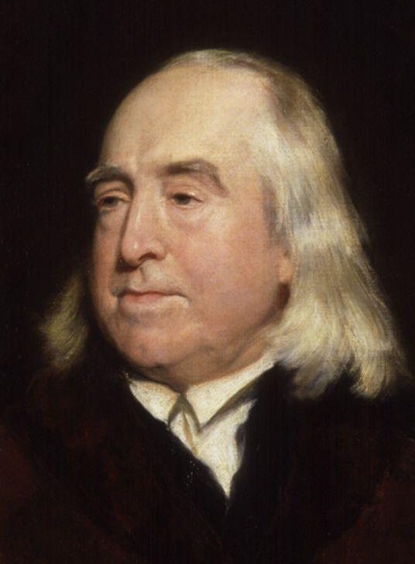
Small Group Discussion
Do you agree with English philosopher Jeremy Bentham when he says:
All punishment is mischief; all punishment in itself is evil

Slide 28
Small Group Challenge
Child Family Community Australia (CFCA) is a government funded information exchange for practitioners, policy makers, service providers and researchers working with children, families and communities. CFCA has an issue …
CFCA is hosting an upcoming forum to discuss the provisions of the Crimes Amendment (Child Protection—Physical Mistreatment) Act 2001(NSW). This legislation legalises the punishment of children by physical force by parents but only if it is reasonable, meaning physical force must not be applied to the head or neck of the child or anywhere else that will cause the child harm that lasts for more than a short period. The law is highly controversial as many parents believe they should be free to discipline their own children as they see fit.
CFCA seeks your advice.
In groups, prepare a submission to the CFCA explaining the purpose of punishment and whether you believe corporal punishment is an appropriate form of disciplinary action for parents to use against their children.

Slide 29
Punishment
Punishment is the imposition of a penalty as retribution for an offence
Punishment has five recognised purposes: deterrence, incapacitation, rehabilitation, retribution, and restitution
Punishment is administered by the government against criminals who have committed a criminal offence against the state

Slide 30
Compensation
Compensation is the award of money or something else in recognition of loss or injury
Compensation or damages for breach of contract are viewed as a ‘substitute’ for performance
The purpose of compensation is to put the plaintiff in the position they would have been in had the contract been performed properly

Slide 31
Punitive Damages
Punitive damages are monetary compensation awarded to punish the defendant for their actions
The objective of contract law is to compensate plaintiffs, not punish defendants
Punitive damages are not awarded by the courts in disputes involving breach of contract

Slide 32
Liquidated Damages
Contracting parties can insert a clause into the contract that specifies the amount of damages recoverable by one party if the other breaches the contract
This is called a liquidated damages clause
The amount specified must be a genuine estimate of loss or it will be regarded as a penalty clause and the court will not enforce it

Slide 33
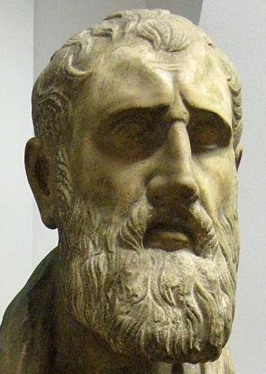
Small Group Discussion
What does Hellenistic thinker Zeno of Citium mean when he says:
Fate is the endless chain of causation, whereby things are; the reason or formula by which the world goes on

Slide 34
Small Group Challenge
The English Court of Appeal has a problem …
The English Court of Appeal is considering the facts of a very old case.
On 2 November 1952, Derek Bentley and his friend Christopher Craig attempted to burgle a confectionery warehouse in South London. A neighbour saw both men climbing over a gate and called the police.
Bentley and Craig were eventually cornered by a police officer who asked Craig to surrender his pistol. Bentley told Craig to, “Let him have it.” Craig shot and wounded the police officer then shot and killed another police officer.
Bentley and Craig were both convicted of murder and on 28 January 1953. Bentley was hanged (Craig was too young to be sentenced to death). Since his execution, Bentley’s family have been fighting a long campaign to have Derek pardoned.
The English Court of Appeal seeks your advice.
In groups, prepare a statement explaining why Derek Bentley should not have been convicted of murder.

Slide 35
Causation & Remoteness
Determining the cause of an event can be a difficult and problematic exercise
A plaintiff seeking compensation for breach of contract must prove that the breach caused their losses
The losses must also be so closely related to the breach that they cannot be said to be too remote:
see Hadley v Baxendale

Slide 36
Losses Recoverable
There are two kinds of loss that a plaintiff may recover:
loss arising from the breach of contract in the usual or normal course of things; and
loss arising from special or exceptional circumstances where it can be shown that the defendant had actual knowledge of the plaintiffs special needs:
see Hadley v Baxendale

Slide 37
Hadley v Baxendale (1854) 156 ER 145
A broken crankshaft stopped operation of a mill.
Baxendale was hired to take at the crankshaft to the maker so that a new one could be made.
Baxendale was unaware of the importance of the shaft.
Due to Baxendale's neglect, the crankshaft was slow in getting to the maker.
This meant the mill was out of operation for a longer period than it should have been.
The mill owner sued Baxendale for loss of profits caused by the delay.
The court held that:
It was not in the usual course of things that the mill would stop altogether because of a broken crankshaft.
It was reasonably possible that the mill would have a spare shaft, or that it could acquire one.
The mills losses did not flow from Baxendale's delay.

Slide 38
Privity of Contract
Under the privity rule only a party to the contract has any rights under the contract
The contract imposes obligations only on the parties to the contract:
see Beswick v Beswick

Slide 39
Beswick v Beswick [1968] AC 58
Peter Beswick agreed to sell his business to his nephew if he paid him a certain sum of money for as long as he lived, and then to pay his wife (the appellant) £5 per week after he died.
He died, and the nephew only paid his aunt once before stating that no contract existed between them.
She was also the administratrix of her husband's will.
The court decided that:
The aunt had no right to sue her nephew in her own capacity as she was not a party to the contract.
However, in her capacity as the administratrix she was able to sue him for the specific performance of his promise that was made in the contract.

Slide 40
Problem
Jerry is addicted to soccer. His favourite team is Liverpool FC. So he invented a new program to track and predict soccer scores.
Every betting company in the world wanted the exclusive use of the program. Ben, who is the CEO of Ulose, offers Jerry a lifetime pass to all Liverpool FC matches in return for exclusive use of the program.
Shortly after he enters this contract with Ulose, Jerry is diagnosed with Motor Neurone disease which means that he cannot travel from Australia to England to attends Liverpool FC matches. Jerry is devastated. He telephones Ben and says:
“I took the subject Legal Studies in high school. I remember that contracts can be terminated because of frustration. Well … I’m incredibly frustrated! That means I can terminate the contract.”
Ben says “no” and hangs up the phone.

Slide 41
Issue 1 - Frustration
Issue
Jerry believes he can terminate the contract because he is feeling frustrated.
Rule
A contract can be terminated by frustration which means a supervening event beyond the control of the parties has made the contract incapable of performance: see Taylor v Caldwell
A contract will not be frustrated because a party regrets their commitment, or faces hardship, inconvenience, or material loss: see Davis Contractors Ltd v Fareham Urban District Council
Application
There has been no supervening event beyond the control of Ben and Jerry making the contract incapable of performance. Ben can still perform his contractual obligation by supplying Jerry with soccer tickets. It is irrelevant that Jerry can no longer travel to the matches.
Just because Jerry regrets his commitment this does not amount to frustration. Although Jerry may be feeling ‘frustrated’, the general concept of frustration (an emotion like agitation or disappointment) is not the same as the legal concept of frustration.
Conclusion
Jerry cannot terminate the contract for frustration.

