Slide 1
Law of Torts
BUS107 Commercial Law
Week 5 Lecture

Slide 2
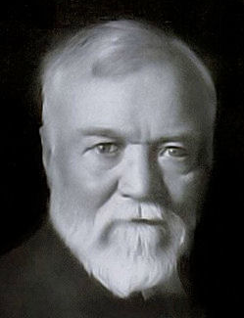
Small Group Discussion
What does Scottish industrialist Andrew Carnegie mean when he says:
Do your duty and a little more and the future will take care of itself

Slide 3
Small Group Challenge
On 7 December 2012, Jacintha Saldanha, a nurse from India working in a London hospital was found dead in her nurse’s quarters. She had hanged herself. Three days prior, two Australian radio show hosts made a prank call to Jacintha impersonating the Queen and Prince Charles.
They asked to speak to the Princess of Cambridge who was a patient at the hospital. Jacintha transferred the call to another nurse who spoke to the pranksters for around two minutes.
In groups, describe the nature of the relationship between Jacintha and the radio hosts.

Slide 4
Negligence - Elements
Duty of Care
Breach of Standard of Care
Causation & Remoteness
Contributory Negligence
Voluntary Assumption of Risk
Statutory Limits

Slide 5
What is a duty of care?
Our words and actions can have deep and lasting impact on other people
Others can suffer injury because of your carelessness
An important relationship arises between you and anyone else who could be injured by your actions
In circumstances where you should be able to predict that someone else could be injured by your actions you owe that person a duty to refrain from those actions

Slide 6
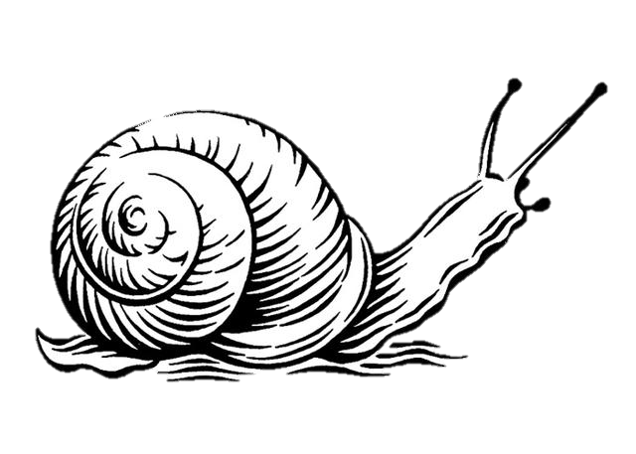
What’s in the bottle?
Ginger
Beer

Slide 7
Who is your neighbour?
When you are about to do something …
… or not do something …
… any person that may be affected …
… that you should consider their wellbeing before you act …
… is your neighbour
: see Donoghue v Stevenson

Slide 8
Donoghue v Stevenson [1932] AC 562
“The rule that you are to love your neighbour becomes in law, you must not injure your neighbour; and the lawyer's question, Who is my neighbour? receives a restricted reply. You must take reasonable care to avoid acts or omissions which you can reasonably foresee would be likely to injure your neighbour. Who, then, in law, is my neighbour? The answer seems to be – persons who are so closely and directly affected by my act that I ought reasonably to have them in contemplation as being so affected when I am directing my mind to the acts or omissions which are called in question”

Slide 9
Recognised duties of care
Authorities – government, police
Builders – to clients, homeowners
Drivers – to passengers, road users
Manufacturers – to consumers
Advisers – to those relying on advice
Occupiers – to visitors, tenants

Slide 10
But I didn’t realise lighting firecrackers in the schoolyard would burn the children. Honestly!
Well … you should have
Why?
Because a reasonable person would have
A what?
A reasonable person is a typical community member with the common sense of that community

Slide 11
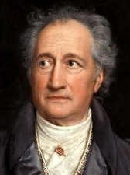
Small Group Discussion
Do you agree with German statesman Johann Wolfgang von Goethe when he says:
Precaution is better than cure

Slide 12
Small Group Challenge
On 24 March 2015, Germanwings co-pilot Andreas Lubitz intentionally crashed a plane in the French Alps killing all 144 passengers and 6 crew members. According to French and German prosecutors, Lubitz locked the pilot out of the cockpit after he left to use the toilet. In response to the incident, aviation authorities in Australia implemented new regulations that require at least two authorised personnel in the cockpit at all times.
In groups, consider whether or not the new regulations will be an effective precaution to stop a similar incident from happening again.

Slide 13
Calculating Risk
Every action we take carries some degree of potential risk to ourselves and to others
Risk can be categorised according to seriousness: insignificant, low, medium, high, extreme
Risk can be determined by assessing the likelihood of occurrence and the seriousness of the consequences

Slide 14
Standard of Care
We are expected to take reasonable precautions to prevent our actions from causing injury to other people
Your actions will fail to meet the standard of care and breach your duty of care to your neighbour if the risk of injury was reasonably forseeable, not insignificant, and you failed to take reasonable precautions: see Civil Liability Acts

Slide 15
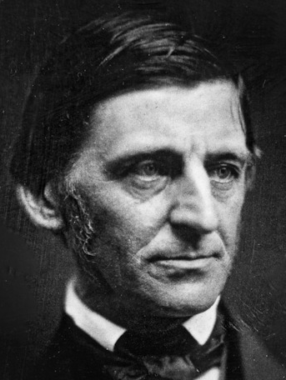
Small Group Discussion
What does American poet Ralph Waldo Emerson mean when he says:
Shallow men believe in luck.
Strong men believe in cause and effect

Slide 16
Small Group Challenge
On a sunny morning in 1943 a black South African woman and her young son were out walking in Sophiatown, the slum they lived in near Johannesburg. A white priest named Trevor Huddleston tipped his hat towards the woman as he passed, a small but extremely unconventional gesture of courtesy between two races separated by apartheid. But the boy never forgot it. To him it suggested that not all white people were oppressive. He grew up to become an instrumental activist in the struggle against apartheid and headed the Truth and Reconciliation Commission. He won the Nobel Peace Prize in 1984 for his efforts in resolving and ending apartheid.
In groups, discuss whether Trevor Huddleston’s gesture caused apartheid to end in South Africa.

Slide 17
Causation
To be recoverable from the defendant the losses incurred must actually be caused by the negligent act
We can ask the question, ‘If the negligent act had never happened would the plaintiff have suffered a loss?’
This is called the ‘but for’ test:
see Cork v Kirby MacLean

Slide 18
Cork v Kirby Maclean Ltd [1952] 1 All ER 1064
C was working on a narrow platform 23 feet above the floor of a factory. There were no guard rails. He had an epileptic fit and fell to his death. He knew he was epileptic, but his employers did not.
His employers were clearly in breach of their duty of care to him, as guard rails should have been fitted. However, they argued that they did not cause his death: they said that the epilepsy killed him.
Rule
If the damage would not have happened but for D’s breach of duty (the lack of guard rails), then D’s breach is the cause of that damage.
Conversely, if the damage would have occurred in any event, then the breach of duty cannot be said to be the cause of C’s damage.

Slide 19
Cork v Kirby Maclean Ltd [1952] 1 All ER 1064
The court held:
If the guard rails had been in place then C would probably have survived – he would still have had a fit, but would not have fallen to his death.
Therefore, C (or rather his widow) proved that his employer’s breach was the factual cause of his death.
There were no intervening events which could be regarded as having broken the chain of causation, so legal causation was also established.

Slide 20
Remoteness
To be recoverable the losses incurred must actually be caused by the negligent act and not be too remote
This means that the damage must not only be a direct consequence of the negligent act, but must have also been reasonably forseeable: see Overseas Tankship (UK) Ltd v The Miller Steamship Co Pty Ltd
Would it be reasonably forseeable to a ship’s engineer that furnace oil spilled into the harbour might catch on fire?

Slide 21
Overseas Tankship (UK) Ltd v The Miller Steamship Co Pty Ltd
The defendant’s crew carelessly allowed a large quantity of oil spill into Sydney Harbour from the defendant’s ship.
The oil settled around a wharf where the plaintiff’s ships were moored.
The oil caught fire when molten metal fell onto some cotton waste floating on the oil.
The fire destroyed the plaintiffs ships.
The court held that:
The ships engineer of the defendant’s ship ought to have known that furnace oil on water had caught fire before.
Once fire was reasonably foreseeable, the possibility of damage to ships in the vicinity was also reasonably foreseeable.
The defendant was held liable.

Slide 22
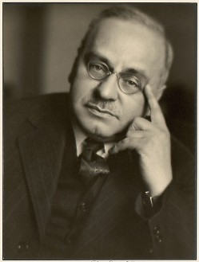
Small Group Discussion
Do you agree with Austrian psychologist Alfred Adler when he says:
The chief danger in life is that you may take too many precautions

Slide 23
Small Group Challenge
The Australian Association of Adventurers (AAA) has a serious problem …
The Association is shocked by a recent case from New Zealand where an injured customer successfully sued an adventure tour business in negligence for the damage done to her spine whilst performing a bungee jump.
The President of the AAA is worried that adventure services businesses in Australia that offer high risk activities such as skydiving, hang gliding, and jet boat cruises may also be exposed to negligence claims if their customers sustain injuries.
The President of the AAA seeks your advice.
In groups, prepare at least two strategies that AAA can recommend to its members to protect them from negligence claims.

Slide 24
Voluntary Assumption of Risk
We cannot blame or sue others for injuries sustained where we have understood and accepted the risks involved
Voluntary assumption of risk is a complete defence to an action in negligence

Slide 25
Contributory Negligence
Where a person is also careless regarding their own safety the court will apportion the negligence between the plaintiff and the defendant and award damages accordingly: see Imbree v McNeilly
If you cross the road carelessly and get hit by a car being driven carelessly then your own negligence will have contributed to your damages

Slide 26
Imbree v McNeilly
The plaintiff was injured in a motor accident
The plaintiff was “supervising” the defendant driver.
The defendant driver was 16 years of age and had just obtained a learner’s permit.
The plaintiff knew that he was inexperienced.
The defendant attempted to steer the vehicle to avoid tyre debris on the road.
Despite the plaintiff yelling at him to brake, the defendant turned sharply to the left and accelerated, causing the vehicle to roll.
The plaintiff suffered spinal injuries in the accident and was rendered a tetraplegic.

Slide 27
Imbree v McNeilly
The court held
An inexperienced driver owes the same standard of care as any other person driving a motor vehicle – to take reasonable care to avoid injury to others.
The obligation to drive to the standard of a reasonable driver is not to be qualified by reference to the holding of a licence or by reference to the driver’s level of experience.
Inexperience remains relevant to the assessment of contributory negligence.
The plaintiff was found to be contributorily negligent due to his failure, having observed the debris on the road, to instruct the defendant.
The plaintiff’s responsibility for the accident was not insignificant and was assessed at 30%.

Slide 28
Negligent Misstatement
People providing information such as professional advisers and information officers owe a duty of care to those they advise to avoid making careless statements that cause harm

Slide 29
Civil Liability Acts
Claims for personal injuries under the common law of negligence have now been limited by the Civil Liability Acts
This legislation promotes personal responsibility
The Civil Liability Acts place a statutory cap on general damages for claims for personal injury and death around $400,000-$500,000

