Slide 1
Revision – Consumer Law
What is consumer protection? Explain the definition of a consumer under the Australian Consumer Law (ACL).
What is misleading and deceptive conduct? What are the types of behaviour that can be misleading and deceptive conduct?
What is a statutory guarantee? Discuss the statutory guarantee that goods supplied must correspond to description.
What is a safety ban? Research the Product Safety Australia website and identify three items that have been permanently banned.

Slide 2
Agency
BUS107 Commercial Law
Lecture Nine

Slide 3
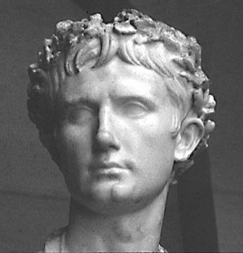
Small Group Discussion
Do you agree with Roman poet Horace when he says:
To save a man’s life against his will is the same as killing him

Slide 4
Small Group Challenge
Bob is a 62 year old bus driver. While mowing the lawn he had a heart attack. Due to lack of oxygen, he suffered brain damage. Doctors were able to keep him alive but only by putting him on life support. His breathing is now performed for him by a ventilator and he is fed by a feeding tube. His brain damage is extensive and his doctors believe that even if he does recover he will have severe and permanent mental impairment.
Bob’s brother Joe knows that Bob would not wish to be kept alive under these circumstances. Over the years they had many conversations together about how if one of them ever ended up on life support the other one would end it mercifully by ‘flicking the switch’. But Mary, Bob’s wife, is so devastated by grief that she will not even consider this as an option. She is determined to keep Bob alive no matter what.
In groups, work out strategy that could have allowed Bob’s wishes to be followed even though he now lacks the capacity to make decisions for himself.

Slide 5
Agent
People suffering from dementia or a brain injury or unconsciousness due to illness lack the capacity to make decisions concerning their ongoing medical care
An agent is someone you authorise to make decisions on your behalf such as entering contracts
Notes:
Specific understandings from our big idea.

Slide 6
Principal
An agent is engaged by a principal
A principal gives the agent the authority to act on behalf of the principal
A principal may authorise an agent to enter into contracts on behalf of the principal
The agent will negotiate and execute the agreement but is not a party to the agreement because they act on behalf of the principal
It is the principal that will be bound by the agreement, not the agent

Slide 7
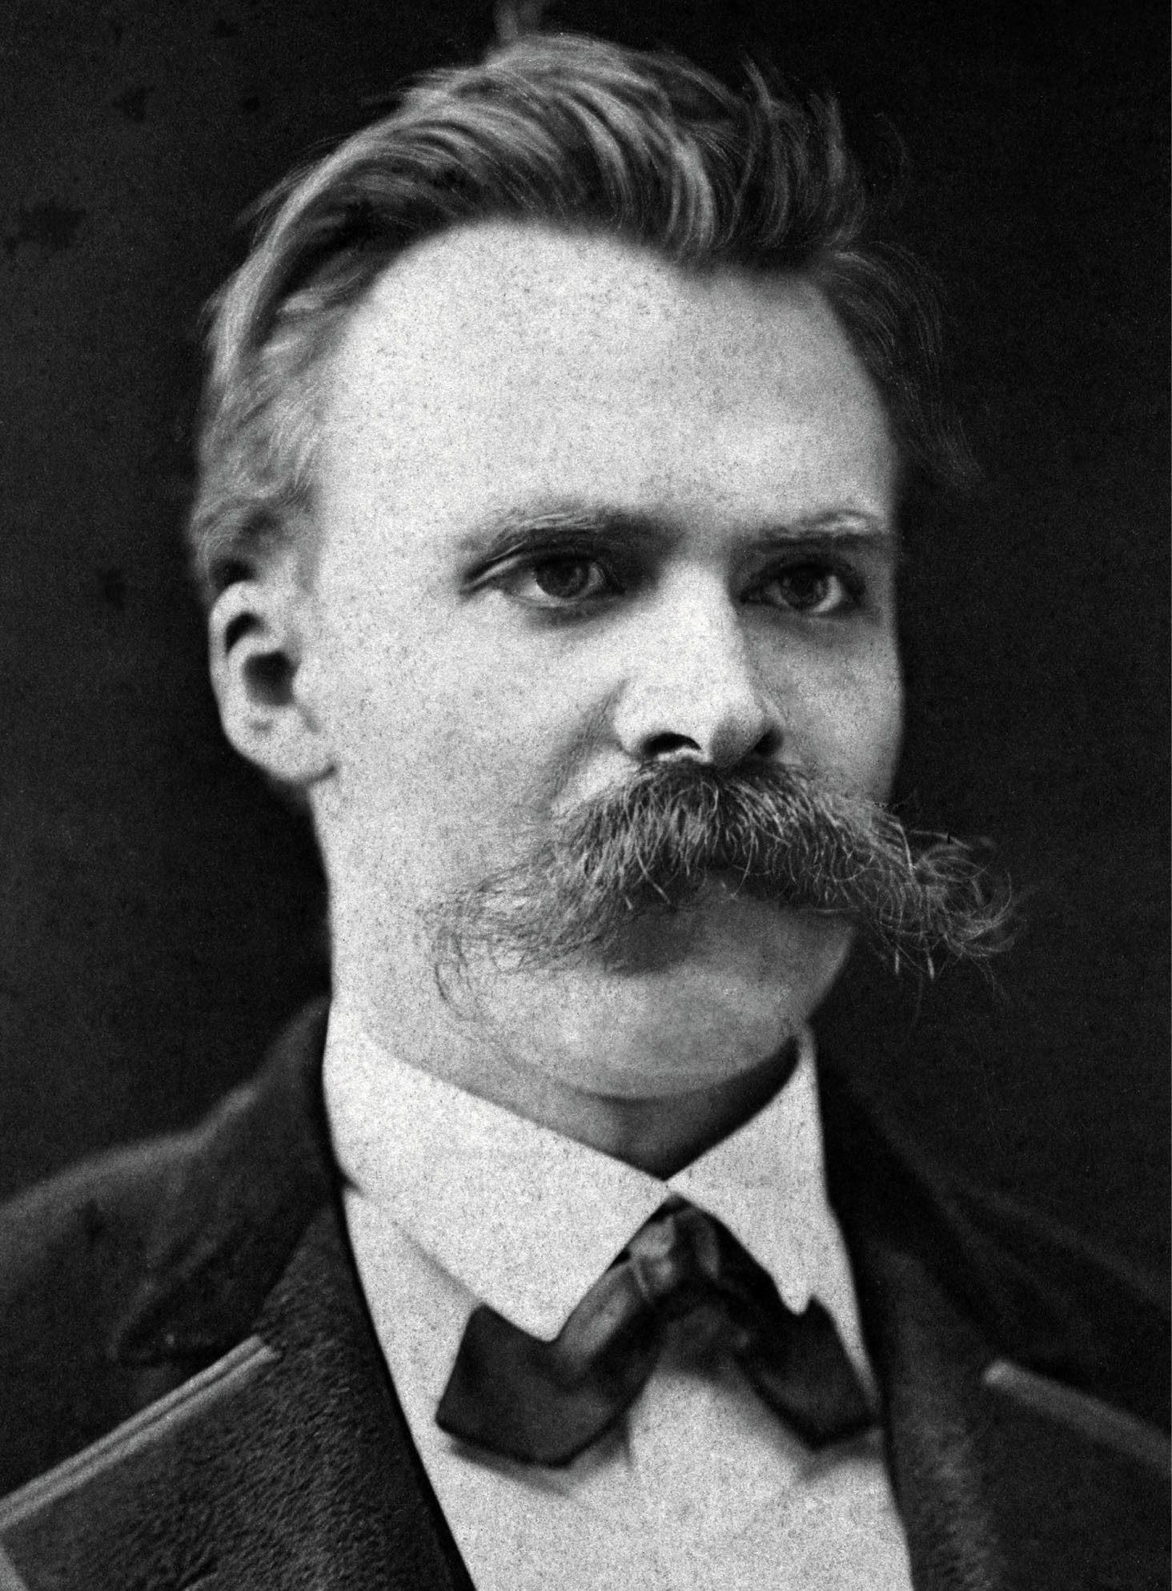
Small Group Discussion
What does German philosopher Friedrich Nietzsche mean when he says:
Few men are made for independence, it is the privilege of the strong

Slide 8
Small Group Challenge
The Franchise Council of Australia (FCA), an industry body representing the interests of franchisors, has a problem …
Member franchisors are reporting suppliers are suing them directly for non payment by their franchisees. The suppliers argue the franchisees act on behalf of the franchisor which means non payment by the franchisee is actually non payment by the franchisor. The franchisors claim their franchisees are not agents but independent contractors acting only for themselves.
The FCA seeks your advice.
In groups, develop at least three indicators that could be used to differentiate between an agent and an independent contractor.

Slide 9
Agent or Independent Contractor?
An agent acts on behalf of a principal
An independent party is free to act purely for themselves
An independent party can enter contracts on their own behalf but has no authority to bind anybody else to a contract
Notes:
Specific understandings from our big idea

Slide 10
Indicators of Agency
An agent is more likely than an independent contractor to:
pay across monies to a principal
be paid on a commission basis
have to report back and account to the principal on all matters connected to their business:
see International Harvester Co of Australia v Carrigan Hazeldene Pastoral Co

Slide 11
International Harvester v Carrigan Hazeldene Pastoral Co
H & K described themselves as the "agent" for International Harvester
H & K bought a machine from International Harvester
H & K sold the machine to Carrigan
The machine broke down
The court held:
No Principal and Agent relationship existed between IH and H & K with respect to the sale to Carrigan
Use of the word "agency" or "agent" does not of itself create an agency at law (though it may indicate one)
International Harvester was not liable to Carrigan

Slide 12
Independent Contractor - ATO
Employee | Contractor
Ability to subcontract/delegate: the worker can't subcontract or delegate the work – they can't pay someone else to do the work. | Ability to subcontract/delegate: the worker can subcontract/delegate the work – they can pay someone else to do the work.
Basis of payment – the worker is paid either: for the time worked a price per item or activity a commission. | Basis of payment: the worker is paid for a result achieved based on the quote they provided. A quote can be calculated using hourly rates or price per item to work out the total cost of the work.

Slide 13
Independent Contractor - ATO
Employee | Contractor
Equipment, tools and other assets: your business provides all or most of the equipment, tools and other assets required to complete the work, or the worker provides all or most of the equipment, tools and other assets required to complete the work, but your business provides them with an allowance or reimburses them for the cost of the equipment, tools and other assets. | Equipment, tools and other assets: the worker provides all or most of the equipment, tools and other assets required to complete the work the worker does not receive an allowance or reimbursement for the cost of this equipment, tools and other assets.
Commercial risks: the worker takes no commercial risks. Your business is legally responsible for the work done by the worker and liable for the cost of rectifying any defect in the work. | Commercial risks: the worker takes commercial risks, with the worker being legally responsible for their work and liable for the cost of rectifying any defect in their work.

Slide 14
Independent Contractor - ATO
Employee | Contractor
Control over the work: your business has the right to direct the way in which the worker does their work. | Control over the work: the worker has freedom in the way the work is done, subject to the specific terms in any contract or agreement.
Independence: the worker is not operating independently of your business. They work within and are considered part of your business. | Independence: the worker is operating their own business independently of your business. The worker performs services as specified in their contract or agreement and is free to accept or refuse additional work.

Slide 15
Creation of Agency
An agency relationship can be created by:
express agreement – actual authority given orally or in writing
implied agreement – from actions or relationships such as cohabitation or partnership
estoppel – principal terminates agent but does not notify third parties:
see Pole v Leask

Slide 16
Pole v Leask
No one can become the agent of another person except by the will of that other person. His will may be manifested in writing or orally, or simply by placing another in a situation in which, according to the ordinary rules of law, or perhaps it would be better to say according to the ordinary usages of mankind, that other is understood to represent and act for the person who has so placed him."

Slide 17
Secret Agents

Slide 18
Small Group Discussion
Do you agree with US President Richard Nixon when he says:
When the President does it that means it’s not illegal
Notes:
The big idea is authority

Slide 19
Small Group Challenge
The Minister for Foreign Affairs has a problem …
The Director-General of Security at the Australian Security Intelligence Organisation (ASIO) is pressuring the Federal Parliament to pass new legislation giving ASIO officers carte blanche, that it, full discretionary power. The new laws would give ASIO officers greater immunity from prosecution if they commit a crime. The Minister of Foreign Affairs is worried that these powers would permit ASIO officers to cause significant damage to property and commit assault, torture, sexual assault, and murder.
The Minister for Foreign Affairs seeks your advice.
In groups, draft a legislative provision that limits the discretionary power of ASIO officers and addresses the Minister’s concerns.

Slide 20
Agent’s Authority
It can be dangerous for a principal to confer carte blanche or full discretionary power upon their agent
A principal can protect themselves from liability to others by placing limitations on the scope of their agent’s authority
A principal will be liable for the actions of their agent if those actions were performed within the scope of the agent’s authority
Notes:
Specific understandings from our big idea.

Slide 21
Actual Authority
Actual authority can be given to an agent expressly, that is either verbally or in writing
Actual authority can also be implied in the following ways:
custom or trade usage
course of past dealings
conduct of the principal, such as appointing the agent to a position within a business:
see Snowy Mountains Hydro case

Slide 22
Snowy Mountains Hydro case
A Belgian manufacturer (Principal) appointed an Australian company (Agent) to be its agent to contract with the Snowy Mountains Hydro- Electric Authority (TP).
TP’s cheques for the Principal were paid to the Agent in Australia in Australian dollars
The Agent banked the cheques because the Principal did not have an account in Australia.
The Agent did not forward some of the money to the Principal
The Agent went bankrupt
The Principal sued the bank and claimed that the Agent did not have authority to bank its cheques into the Agent’s account.

Slide 23
Snowy Mountains Hydro case
The court held:
Because the Principal had no bank account in Australia, the Agent had implied actual authority to bank the cheques into its account
The Agent’s authority to bank the cheques was both:
express actual authority (through the original agreement), and
implied actual authority (to give ‘‘business efficacy’’ to the operation of the agency).

Slide 24
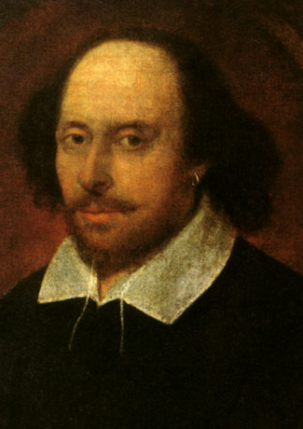
Small Group Discussion
What does English playwright William Shakespeare mean when he says:
All that glitters is not gold
Notes:
The big idea is illusion.

Slide 25
Small Group Challenge
A father and his son are in a car accident. The father dies instantly, and the son is taken to the nearest hospital. The doctor comes in and exclaims,
‘I can’t operate on this boy!’ ‘Why not?’ the nurse asks. ‘Because he’s my son,’ the doctor responds.
In groups, solve this riddle.

Slide 26
Ostensible Authority
Appearances can be deceiving
Ostensible or apparent authority is the authority that an agent appears to have but does not actually have
It arises where the principal has done something to cause the agent to appear as though they have actual authority
Notes:
Specific understandings from our big idea.

Slide 27
Ostensible Authority
For an agent to have ostensible authority there must be
a holding out
by someone with actual authority, and
a third party must have relied on it:
see Freeman & Lockyer v Buckhurst Park Properties (Mangal) Ltd

Slide 28
Freeman & Lockyer v Buckhurst Park Properties (Mangal) Ltd
K and H formed a company
K and H were directors of the Company
No managing director was ever formally appointed but K acted as managing director with the company’s knowledge (it acquiesced).
K contracted with the plaintiff (TP) to do work.
The court held:
K had no actual authority to employ TP but had the apparent authority of a managing director.
The company was bound by the contract with TP

Slide 29
Scope of Authority
The scope of an agents authority is made up of:
Actual express authority
Actual implied authority
Ostensible authority
Actions beyond this scope are unauthorised
Notes:
Specific understandings from our big idea.

Slide 30
Beyond the Scope of Authority
Where an agent acts beyond the scope of their authority their actions are not binding on the principal
The contracting third party may sue the agent for misrepresentation or breach of warranty of authority

Slide 31
Contractual Disputes
A contracting third party can enforce a contract against the principal where the agent has acted within their actual or ostensible authority
But a principal can only enforce a contract against a contracting third party where the agent has acted within their actual authority
But a principal can ratify an agent’s act without authority and then will be bound

Slide 32
Agent duties
The agency relationship is based on contract and is a fiduciary relationship
The duties owed by the agent are:
to follow the principal’s instructions
to use reasonable diligence, care and skill
to act in person
to act in the principal’s interests
to not disclose confidential information
to keep the principal’s money separate

Slide 33
Termination of agency
An agency agreement can be ended by:
agreement
revocation of agent’s authority
death, incapacity, bankruptcy of agent or principal
illegality of subject matter
frustration of contract
dissolution of company

