Slide 1
Revision - Agency
What are the ways that an agency can be created?
Express (written or oral)
Implied (from actions or relationships)
Estoppel (principal does not notify others of termination of agency )
What are 3 types of authority that an agent can have?
Actual
Implied
Ostensible (or Apparent)
What is the test for Ostensible (or Apparent) Authority?
Someone with actual authority
Holds out that another person is an agent, and
A third party has relied on the holding out

Slide 2
Partnership
BUS107 Commercial Law
Lecture Ten

Slide 3
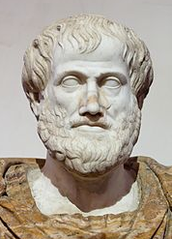
Small Group Discussion
Do you agree with Roman philosopher Aristotle when he says:
Friendship is essentially a partnership

Slide 4
Small Group Challenge
Imagine you work for an online legal dictionary. Your job is to compose definitions for legal concepts without reference to any other dictionaries.
The following three rules of composition offer some assistance:
A concept can be defined by identifying and explaining its essential elements or characteristics;
A concept can be defined by using examples to illustrate meaning;
A concept can be defined by identifying what it is not.
In groups, use the three rules of composition to define the legal concept of partnership.

Slide 5
Definition of Partnership
Legal concepts should be defined with as much precision as possible to foster clarity of understanding and ease of application
Just because a business describes itself as a partnership doesn’t mean it is one – it must fit the statutory definition
A partnership is defined as the relationship between persons carrying on a business in common with a view to profit:
see s.1 Partnership Act

Slide 6
Elements of Partnership
Carrying on a business means an ongoing series of activities that are commercial in nature; not a hobby
In common means the partners act for and on behalf of all the other partners
With a view to profit means having an intention to generate profit, not operate a charity or sporting club:
see s.1 Partnership Act

Slide 7
Further Definition of Partnership
An arrangement between two or more people is not automatically a partnership just because they:
own property together
share gross returns
share profit:
see s.2 Partnership Act

Slide 8
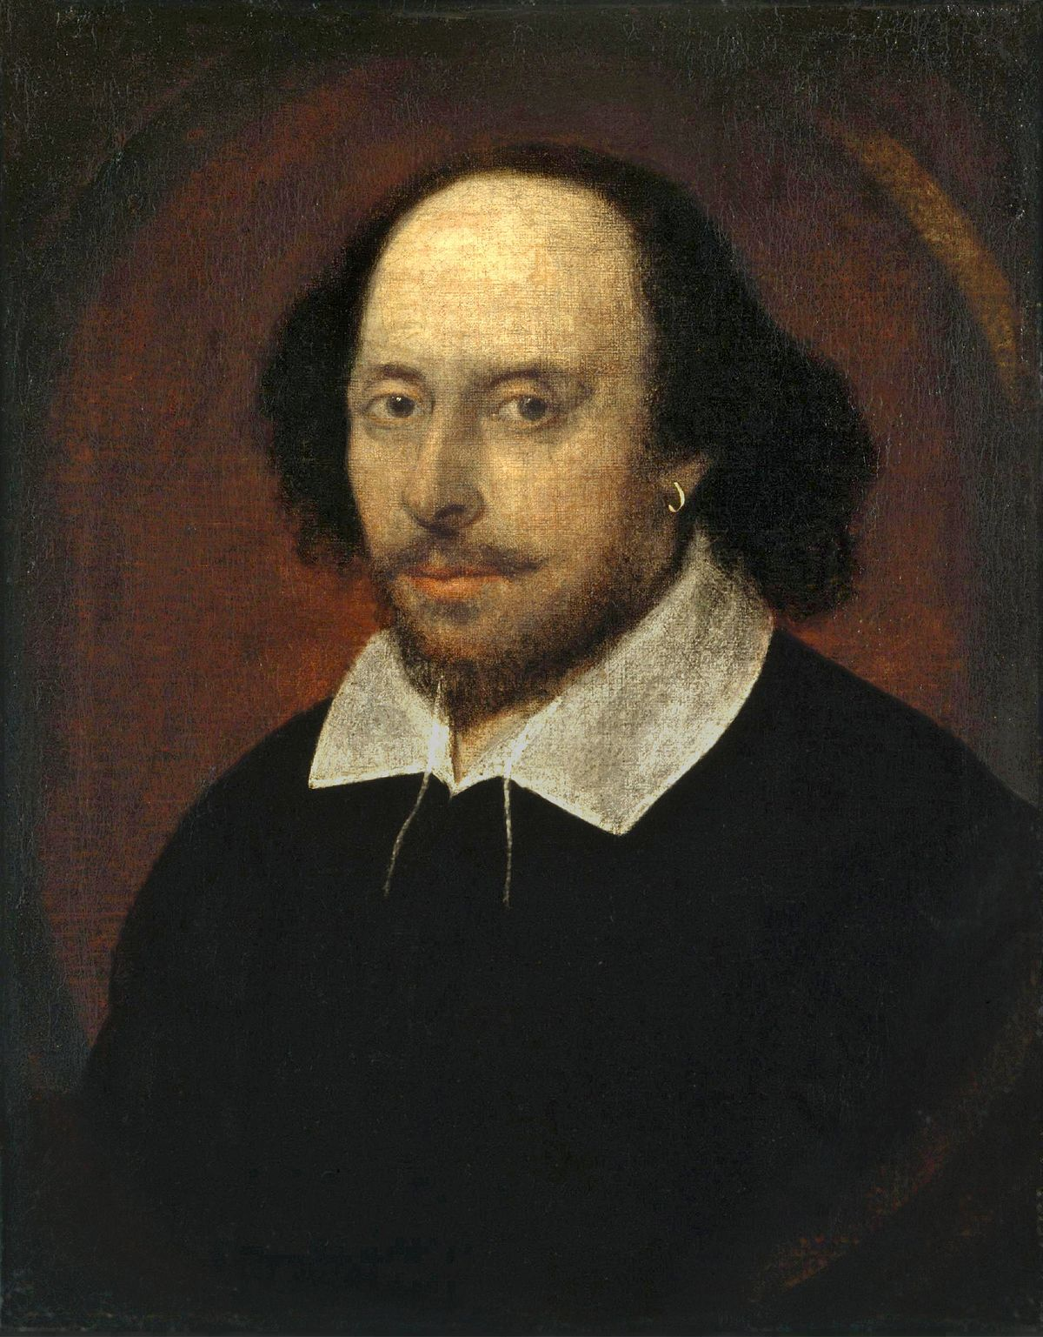
Small Group Discussion
Do you agree with English playwright William Shakespeare when he says:
Love all, trust a few, do wrong to none

Slide 9
Small Group Challenge
The Australian Chamber of Commerce and Industry (ACCI) has a serious problem …
The ACCI is worried by the results of a recent study revealing a lack of trust between partners as the primary reason for partnership dissolution. The study identifies a sharp rise in the incidence of the following activities:
i) partners using partnership property for personal reasons;
ii) partners taking business opportunities away from the partnership;
iii) partners making secret commissions;
iv) partners directly competing with the partnership business through other ventures.
The ACCI seeks your advice.
In groups, draft a code of conduct that would prohibit partners from engaging in these activities.

Slide 10
Trust
Trust is reliance on the integrity of another person
A person who holds a legal relationship of trust with another person is called a fiduciary
A fiduciary owes the other person fiduciary duties
Partners owe fiduciary duties to each other

Slide 11
Fiduciary Duties
Fiduciary duties require partners to:
Act in good faith
Make full disclosure
Account for benefits derived from dealing with the partnership
Account for the use of partnership assets
Not compete with the partnership

Slide 12
Partnership Contract
A partnership contract will govern the relationship between the partners:
see Bryant Bros v Thiele
Where no partnership contract exists the Partnership Acts of each state impose a set of rules governing the relationship between the partners:
see s.24 Partnership Act

Slide 13
Partnership Property
Partnership property includes items:
brought into the partnership as partnership property
acquired on behalf of the partnership
acquired in the course of running the partnership business
see Harvey v Harvey

Slide 14
Harvey v Harvey
HH was unable to farm his land due to ill health but wanted to keep it for his six-year-old son.
The defendant's brother (HL) suggested that he and his sons work the land so HL’s sons could gain farming experience and the land would still be available for HH’s son.
HL and his sons contributed labour but no capital
HH provided stock and implements but no labour.
Expenses, including the costs of improvements to the land, and profits were shared equally.
HL & his sons made substantial improvements to the land
There was no agreement as to how to account for improvements
The land was not listed in the accounts as a partnership asset nor was it credited to HH’s capital account
The agreement ran for 20 years.

Slide 15
Harvey v Harvey
The Court found that:
The arrangement was clearly intended to be a partnership.
The parties intended to keep the land for HH's son. If the land had become partnership property this objective would have been defeated.
The land did not become an asset of the partnership.
The cost of the improvements (with no allowance for labour) was to be deducted from HH's share of the partnership property.

Slide 16
Small Group Discussion
Do you agree with Australian child psychologist Michael Carr-Gregg when he says:
Parents should be held legally and financially responsible when their kids bully other kids
Notes:
Third party liability

Slide 17
Small Group Challenge
A member of the NSW Parliament has introduced a proposed amendment to the Companion Animals Act 1998.
The amendment seeks to abolish section 25 which states:
The member argues that no person should ever be liable for damages that they themselves did not cause.
In groups, write a short letter to your local member explaining why they should vote against the proposed amendment.

Slide 18
Third party liability
Liability for someone else's actions may arise because of the nature of the relationship you have with that person
Partners are jointly liable for the debts and wrongful acts of the partnership:
see ss.9-10 Partnership Act

Slide 19
Partnership Debts
A debt is a partnership debt when:
the transaction giving rise to the debt was conducted in the usual way the partnership is conducted
the partner acted within either actual or ostensible authority in entering the debt on behalf of the partnership
unless the third party knew the partner had no authority or did not know the partner was a partner:
see s.5 Partnership Act

Slide 20
Wrongful Acts
A partnership be liable for a wrongful act when:
the wrongful act arose in the conduct of the ordinary business of the partnership: see s.10 Partnership Act
even if the partner that committed the wrongful act was not authorised to act in that manner:
see Polkinghorne v Holland & Whittington

Slide 21
Polkinghorne v Holland & Whittington
The plaintiff entered into transactions on the advice of H, a member of a firm of lawyers
He invested £5,000 in 2 companies and guaranteed the bank overdraft of a third company of which H was a director.
H knew that each of the companies was financially unsound when he gave the advice
The plaintiff lost the £5,000 and had to make payments under the guarantee

Slide 22
Polkinghorne v Holland & Whittington
The court held:
H had a duty to investigate the financial stability of the companies when advising the plaintiff and to disclose the facts within his knowledge to the plaintiff.
This duty was owed by H in the ordinary course of the business of his law firm, and its breach meant his innocent partners were responsible for the loss of the client’s money.
H had not acted within the scope of his authority as a partner or within the ordinary course of business as a solicitor when he asked the client to sign the guarantee and so the innocent partners were not liable.

Slide 23
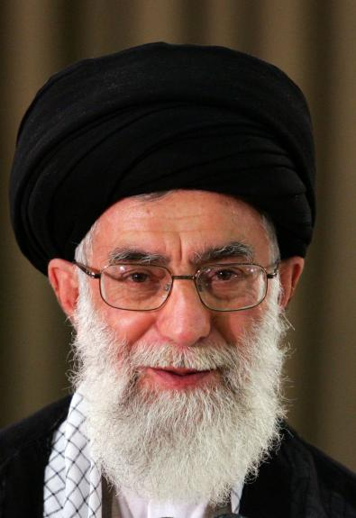
Small Group Discussion
Do you agree with Iranian Grand Ayatollah Ali Khamenei when he says:
The Americans are stuck in Iraq and have no way out. They are like a wolf whose tail has been caught in a trap
Notes:
Extraction

Slide 24
Small Group Challenge
Tori Simpson, a senior partner in a large accounting firm, has an issue…
She has lost confidence in her firm’s partners and wants to leave the partnership. She understands that partners are liable for the debts and liabilities of the partnership but wants to ensure she is not accountable for any debts and liabilities incurred by the partnership after she leaves. The other partners want her departure to remain confidential. Tori believes they are worried many of the firm’s clients would go elsewhere if they knew she was leaving. She also thinks they want new clients to continue engaging the firm under the mistaken belief she is still a partner there.
Tori seeks your advice.
In groups, prepare an exit strategy for Tori that protects her from liability against future debts and liabilities of the partnership.

Slide 25
Leaving the Partnership
Partners can continue to be liable for future debts and liabilities of a partnership even after they have left the partnership
A person dealing with a partnership can treat ex-partners as current partners until they are notified of the departure
A person who has not had dealings with a partnership can treat ex-partners as current partners unless they have notice of the departure e.g. it is advertised in a local newspaper and the Government Gazette:
see s.36 Partnership Act

Slide 26
Expulsion of a Partner
No majority of the partners can expel any partner unless a power to do so has been conferred by express agreement between the partners:
see s.25 Partnership Act
This means the partnership contract would have to include an expulsion provision

Slide 27
Termination of Partnership
A partnership can be terminated by:
agreement
operation of law (e.g. bankruptcy, death, incapacity)
supervening illegality
court order
After termination:
The partners remain liable for partnership debts and wrongful acts committed or incurred prior to termination

Slide 28
Problem
A partner has borrowed $600,000 on the partnership account to fund his own, separate business interests.
He is also giving business advice to the firm’s clients that he is not qualified or authorised to give. The firm could be held responsible for any client losses stemming from that advice.
The partnership contract contains the following term:
“If any partner shall at any time commit a breach of any of their fiduciary duties the other partners may resolve by majority vote to expel the partner so in default.”
Discuss:
The elements required to meet the legislative definition of a partnership.
The fiduciary duties the rogue partner may have breached
What action the firm may take against the rogue partner for breach of fiduciary duties
The circumstances in which joint liability can arise for partnership debts and wrongful acts
The circumstances in which partners may expel their co-partners.

