Slide 1
Companies
BUS107 Commercial Law
Lecture Eleven

Slide 2
Small Group Discussion
What does American writer Washington Irving mean when he says:
That happy age when a man can be idle with impunity
Notes:
Impunity

Slide 3
Small Group Challenge
The Australian Government Minister for Health has a problem …
Large and powerful industry bodies representing the interests of the sugar industry are lobbying for legislative reform. New scientific research has conclusively linked obesity, diabetes, and heart disease to the consumption of sugar, even at levels currently recommended by the Department of Health. The industry bodies want new laws to grant them impunity and protect them against potential litigation.
The Minister for Health seeks your advice.
In groups, come up with at least two reasons why industries, organisations, and individuals should not be granted impunity for the harm they cause to others.

Slide 4
History
The government wanted to encourage industry and trade
This required large amounts of venture capital
Partnerships were used but
Investors were liable for partnership debts
Large partnerships were difficult to manage
Government created companies so investors (shareholders) would not be liable and could safely leave management to a small board
Businessmen soon realised this structure could be used to manage financial risk by sheltering business owners from business debts

Slide 5
Limited Liability
Impunity is immunity from detrimental effects either caused directly by your actions or facilitated by your participation
Companies are separate legal entities, that is, they are separate from their directors and shareholders
Notes:
Specific understandings about our big idea

Slide 6
Limited Liability
The shareholders of a company have limited liability for the debts and liabilities of the company
Directors and shareholders are not personally liable for the debts or actions of the company:
see Salomon v A Salomon & Co Ltd

Slide 7
Salomon v A Salomon & Co Ltd
Saloman was a sole trader
He sold his business to a company
The shareholders were him, his wife & 5 sons
His family held their shares on his behalf
He was the managing director
It was a “one man” company
The company went into liquidation
The company creditors claimed Saloman was liable for the companies debts as the company was merely an “alias” for Saloman

Slide 8
Salomon v A Salomon & Co Ltd
The court held:
The company was a separate entity from its shareholders
It had conducted the business in its own right and not as an “alias” for Salomon
The debts belonged to the company

Slide 9
Companies
A company has full legal capacity and can do all things a natural person can such as buy and sell property, enter contracts, sue and be sued
It can also issue shares and debentures:
see s.124 Corporations Act

Slide 10
Companies and contracts
As a company is an artificial entity it must act through its human agents: directors, employees, and authorised agents
For a company to be bound, two director signatures or a director and a company secretary signature (can be same person if a one director Pty company) are required on the contract:
see s.127 Corporations Act
Alternatively, a company can be bound where the contract is entered into by an authorised agent on behalf of the company:
see s.126 Corporations Act

Slide 11
Authority of company agents
A company can confer three types of authority on an agent:
actual express authority
actual implied authority
ostensible authority:
refer to the lecture on Agency for more information

Slide 12
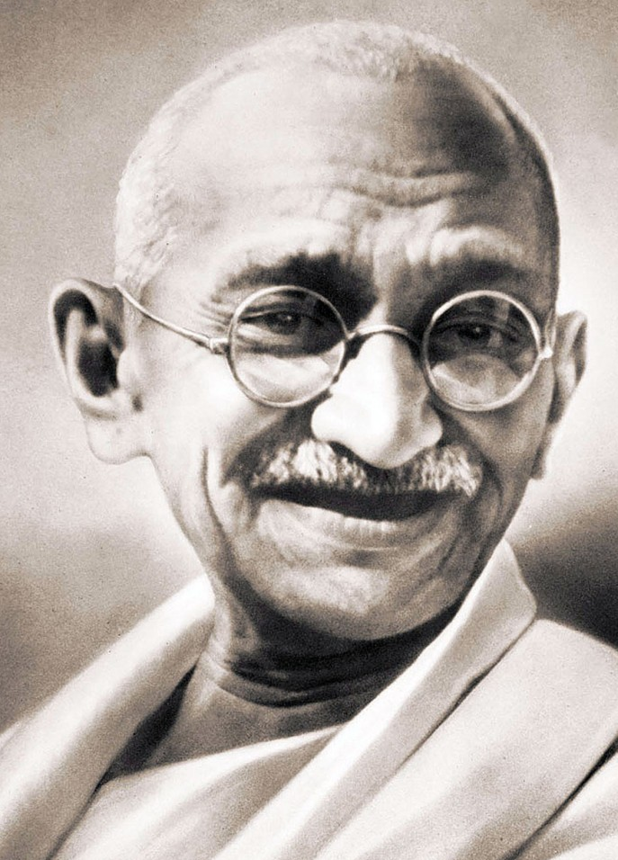
Small Group Discussion
Do you agree with Indian leader Mahatma Gandhi when he says:
Good government is no substitute for self-government
Notes:
Autonomy

Slide 13
Small Group Challenge
Four Kaplan students purchase the board game Monopoly. They love playing the game together so much they become a little obsessed and begin to neglect their studies. The problem seems to be that it takes more than an hour to complete one game.
One of the students recommends they stop playing. This idea is immediately rejected by the others.
Another student proposes setting strict time limits for play. This idea is also rejected on the basis that once a game has begun it should be finished.
In groups, think of at least two ways the students can finish every game they begin without spending so much time playing.

Slide 14
Lord of the Flies

Slide 15
Autonomy
Autonomy or self-governance means exercising control over yourself
Companies may be governed internally by following a set of rules called the replaceable rules
Alternatively, companies may create and follow their own internal governance rules by adopting their own Constitution:
see s.134 Corporations Act
Notes:
Specific understandings about our big idea.

Slide 16
Small Group Discussion
Do you agree with American leader Benjamin Franklin when he says:
Any society that would give up a little liberty to gain a little security will deserve neither and lose both
Notes:
Privacy

Slide 17
Small Group Challenge
In 2015 the Federal Parliament introduced new legislation requiring Australian telcos and ISPs to retain information about customer interactions including time, location, and duration of communications.
The Attorney-General’s Department claims the mandatory data retention scheme has been introduced to combat the rising threat of organised crime and terrorism.
There are widespread concerns:
Who will have access to the collected data?
Who will oversee the government’s use of the collected data?
How will the collected data be protected?
In groups, prepare a submission to the Parliamentary Joint Committee on Intelligence and Security suggesting at least two strategies for ensuring the collected information is not abused.

Slide 18
Privacy
The right to privacy is a fundamental civil liberty that should not be surrendered or compromised without justifiable cause
For companies increased participation in financial markets such as issuing shares to the public or listing on the Australian Securities Exchange requires increased submission to government oversight and surveillance
Notes:
Specific understandings about our big idea.

Slide 19
Proprietary or Public?
Companies may be either proprietary or public
A proprietary company is a privately held company restricted in what it can and cannot do
A public company is a publicly owned company with fewer restrictions but greater oversight and surveillance

Slide 20
Proprietary Company
A proprietary company:
May have as few as one director
Cannot have more than 50 non-employee shareholders
Cannot issue shares or securities to the public, raise funds from the public or list on the Australian Securities Exchange:
see s.113 Corporations Act

Slide 21
Public Company
A public company:
Must have a minimum of three directors
Can have an unlimited number of shareholders
Can issue shares and securities to the public, raise funds from the public and list on the Australian Securities Exchange

Slide 22
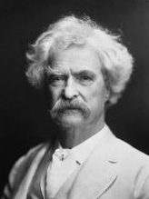
Small Group Discussion
What does American author Mark Twain mean when he says:
It ain’t what you don’t know that gets you into trouble. It’s what you know for sure that just ain’t so.
Notes:
Assumption

Slide 23
Small Group Challenge
Thomas Edison was a great American inventor and innovator. Although he died in 1931, he invented many lasting devices including the motion picture camera and the electric light bulb.
He also had a unique way of conducting job interviews. He would invite job applicants to the company cafeteria and watch them eat soup. If the applicant sprinkled salt on their soup before tasting it, the interview was over.
In groups, figure out why Thomas Edison used this technique to interview job applicants.

Slide 24
Assumptions
Although assumptions may be incorrect they can provide a starting position where independent enquiry is not practical or possible
Third parties contracting with companies can make certain assumptions regarding company conduct and the authority of company agents
Notes:
Specific understandings about our big idea.

Slide 25
Statutory Assumptions
Third parties contracting with companies can assume that:
the company’s internal governance rules are being complied with: see s.129(1) Corporations Act
a director appearing in ASIC records has been duly appointed and has the usual powers of a director in that kind of company:
see s.129(2) Corporations Act
anyone held out by the company as an officer or agent has been duly appointed and has the usual powers of an officer or agent in that kind of company:
see s.129(3) Corporations Act

Slide 26
Statutory Assumptions
Third parties contracting with companies can also assume that:
the officers and agents of the company properly perform their duties to the company: see s.129(4) Corporations Act
However,
third parties contracting with companies are not entitled to make these assumptions if they know they are not true: see s.128(4) Corporations Act

