Slide 1
Directors Duties
BUS107 Commercial Law
Lecture Twelve

Slide 2
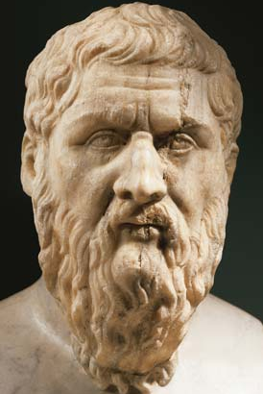
Small Group Discussion
Do you agree with Ancient Greek philosopher Plato when he says:
Honesty is for the most part less profitable than dishonesty
Notes:
Honesty

Slide 3
Small Group Challenge
The National Transport Commission (NTC), an independent statutory body that develops road safety regulations, is facing a dilemma …
A recent review of the safety features of a new car built overseas and imported to Australia has revealed a design flaw that increases the likelihood of the car catching on fire if involved in a collision.
The car manufacturer is aware of the defect and has proposed that instead of recalling and repairing the cars they will set aside a sum of money to cover the cost of settlements for deaths, injuries, and vehicle burnouts.
The NTC seeks your advice.
In groups, advise the NTC on the ethics of selling an item that you know could cause the buyer injury or death.

Slide 4
Honesty
Behaving honestly and fairly is also called acting in good faith
Directors have a duty to act in good faith and in the best interests of the company:
see s.181(1)(a) Corporations Act
The best interests of the company means the best interests of the shareholders as a collective group:
see Greenhalgh v Arderne Cinemas Ltd
Notes:
Specific understandings about our big idea

Slide 5
Greenhalgh v Arderne Cinemas Ltd
G was a minority shareholder
The company had two classes of shares - each hadone vote.
G had 2 shilling shares
M had 10 shilling shares
The company changed the 10 shilling shares into 5 x two shilling shares.
This meant that M now had over 75% of the shares.
The company constitution stated "No shares in the company shall be transferred to a person not a member of the company so long as a member of the company may be willing to purchase such shares at a fair value”.
The company changed its constitution by special resolution to allow shareholders to offer shares to members outside the company.
G argued that the constitutional change was invalid, a fraud on him and the other minority shareholders.
Notes:
Specific understandings about our big idea

Slide 6
Greenhalgh v Arderne Cinemas Ltd
The court held:
It is permissible if the proposed alteration does not unfairly discriminate and is passed in good faith.
The special resolution would be wrong if it discriminated between the majority shareholders and the minority shareholders, so as to give an advantage to the majority only .
Notes:
Specific understandings about our big idea

Slide 7
Proper purpose
Directors have a duty to exercise their powers and discharge their duties for a proper purpose:
see s.181(1)(a) Corporations Act
Directors breach this duty if they issue shares to create or destroy the voting power of majority shareholders:
see Howard Smith Ltd v Ampol Petroleum Ltd

Slide 8
Howard Smith Ltd v Ampol Petroleum Ltd
RWM was subject to a hostile takeover bid by Ampol.
Ampol already controlled 55% of the shares.
Howard Smith Ltd made a rival bid for RWM and offered employment to the RWM directors
The RWM directors issued $10m of new shares which they said was to finance the completion of two tankers.
The shares were given to Howard Smith Ltd and that blocked Ampol’s rival bid.

Slide 9
Howard Smith Ltd v Ampol Petroleum Ltd
The court held:
The directors’ argument that the tanker purchase was the dominant purpose was ‘unreal and unconvincing’.
The power to issue shares must be used “bona fide” & in the interests of the company
The directors actions are not bona fide, even if in the interest of the company, if they have a self-interest
The share issue was for an improper purpose
It would be wrong for the court to substitute its own opinion for that of the management

Slide 10
Small Group Discussion
What does English poet Alexander Pope mean when he says:
To err is human;
to forgive, divine
Notes:
Impunity

Slide 11
E.T.: The Extra-Terrestrial

Slide 12
Small Group Challenge
In1982 the Mars confectionary company, the makers of Mars Bars and M&Ms, rejected an offer of product placement in a new movie about an alien stranded on planet earth. Apparently the Mars company directors didn’t want their M&Ms product associated with an ‘ugly’ alien.
The same offer was accepted by rival confectioner The Hershey Company and their product Reece’s Pieces appears prominently in several key scenes in the film. Hershey Vice President Jack Dowd estimated the product placement caused a tripling in sales.
The rejection by the Mars directors potentially cost their shareholders ten of millions of dollars in lost revenue and brand recognition.
In groups, determine whether the Mars shareholders should be able to seek compensation from the directors for their costly error in judgement.

Slide 13
Care, Skill and Diligence
Directors have a duty to perform with care, skill and diligence:
see s.180(1) Corporations Act
Inevitably, some decisions will turn out to be mistakes
The business judgement rule is a defence for directors who make honest mistakes
Notes:
Specific understandings about our big idea

Slide 14
Care, Skill and Diligence
A director will breach their duty to exercise care, skill and diligence if they fail to demonstrate the same degree of care, skill and diligence that a reasonable person in the same position and circumstances would have demonstrated
All directors must take reasonable steps to place themselves in a position to guide and monitor the management of a company: see Daniels v Anderson

Slide 15
Daniels v Anderson
AWA adopted a strategy to hedge against FX (foreign currency) exposure.
Oversight was left to a general manager and finance manager, neither of whom had experience with FX transactions
AWA suffered substantial losses
Early profitable figures were based on speculative trades, failure to disclose losses and by paying losses with funds borrowed from banks.

Slide 16
Daniels v Anderson
The court held:
A director is responsible for ensuring that he or she understands the duty a director is to perform.
That duty will vary according to the size and business of the company and the experience or skills that the director held himself out as having when appointed as a director
A director’s ignorance and failure to inquire are not a protection against liability for negligence
Directors can't rely on being non-executive directors who have no knowledge in the area

Slide 17
Business Judgement Rule
A director will not be in breach of their duty to exercise care, skill and diligence when making a business judgement if they:
make the judgement in good faith for a proper purpose; and
do not have a material personal interest in the subject matter of the judgement; and
inform themselves about the subject matter of the judgement to the extent they reasonably believe to be appropriate; and
rationally believe that the judgement is in the best interests of the corporation
see s.180(2) Corporations Act

Slide 18
Reliance
It also is reasonable for directors to rely on information or advice provided by others such as company employees or professional advisers but only if the reliance is made in good faith and after making an independent assessment of the information:
see s.189 Corporations Act

Slide 19
Conflict of Interest

Slide 20
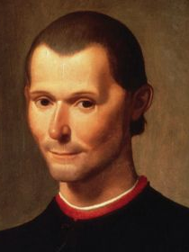
Small Group Challenge
What does Italian philosopher Niccolo Machiavelli mean when he says:
Love is held by a chain of obligation which, men being selfish, is broken whenever it serves their purpose
Notes:
Selfishness

Slide 21
Small Group Challenge
The Financial Planning Association (FPA), an industry association that promotes the interests of financial planners, has a serious issue ...
The Federal Government has released draft legislation that will ban commission payments to financial planners from the sale of financial products to their clients.
The FPA is opposing the draft legislation on the basis that commission payments do not create a conflict of interest for financial planners. The FPA is also claiming that the legislation is unnecessary because the association prosecutes unethical behaviour with its own investigation officers and disciplinary review tribunal.
The FPA seeks your advice.
In groups, prepare a brief to the FPA explaining what a conflict of interest is and why commission payments and self policing structures both contain inherent conflicts of interest.

Slide 22
Conflict of Interest
Managers and advisers are often placed in situations where they must choose between acting in their own interests or in the interests of those they are engaged to serve
Directors owe general law and statutory duties to their companies to avoid situations where they have a conflict of interest: see ss.181-183 Corporations Act
Notes:
Specific understandings about our big idea

Slide 23
Conflict of Interest
A director will have placed themselves in a position of conflict if they:
have a personal interest in a transaction with their company
make an undisclosed personal profit from the use of their position
misuse company funds
take up a business opportunity that should have gone to the company
misuse confidential company information
compete with the company

Slide 24
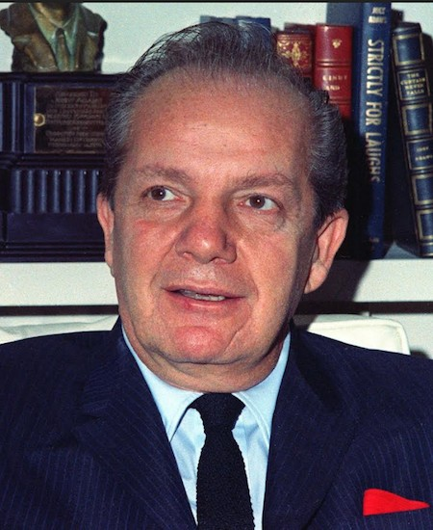
Small Group Discussion
What does American comedian Joey Adams mean when he says:
Bankruptcy is a legal proceeding in which you put your money in your pants pocket and give your coat to your creditors
Notes:
Creditor protection

Slide 25
Small Group Challenge
The Australian Retail Credit Association (ARCA), an industry association for credit providers, has a problem …
The ARCA has issued a warning to its members about the risks of lending money to companies.
The warning explains that a company is a separate legal entity apart from its directors. This means that if the company becomes insolvent the directors cannot be legally compelled to pay back any loans to creditors. Great care must therefore be taken by those lending money to companies to protect themselves should the company become insolvent.
The ARCA seeks your advice.
In groups, work out a least two strategies a creditor lending to a company could use to protect themselves.

Slide 26
Creditor Protection
Creditors can contract to protect themselves by seeking security over company assets when extending credit to companies
Also, when a company is facing insolvency directors are under a duty to consider the interests of both the shareholders and the creditors
Notes:
Specific understandings about our big idea

Slide 27
Duty to Prevent Insolvent Trading
Directors have a duty to prevent insolvent trading:
see s.588G Corporations Act
This means that if the company cannot meet its credit obligations the directors are prohibited from incurring further debts
The duty protects the current creditors and potential creditors

Slide 28
Duty to Prevent Insolvent Trading
A director will have breached their duty to prevent insolvent trading if:
they were a director when the company incurred the debt; and
the company was or became insolvent by incurring the debt; and
there were reasonable grounds for suspecting insolvency at the time; and
the director was aware of those grounds or a reasonable person in the directors position in similar circumstances would have been aware; and
the director failed to prevent the company from incurring the debt

Slide 29
Duty to Prevent Insolvent Trading
A director will have a defence to a breach of their duty to prevent insolvent trading if the director:
expected on reasonable grounds the company would remain solvent; or
reasonably relied on information supplied by somebody else that the company was solvent; or
did not take part in the management of the company at the time the debt was incurred; or
took all reasonable steps to prevent the company from incurring the debt
see s.588H Corporations Act

